Slide 1
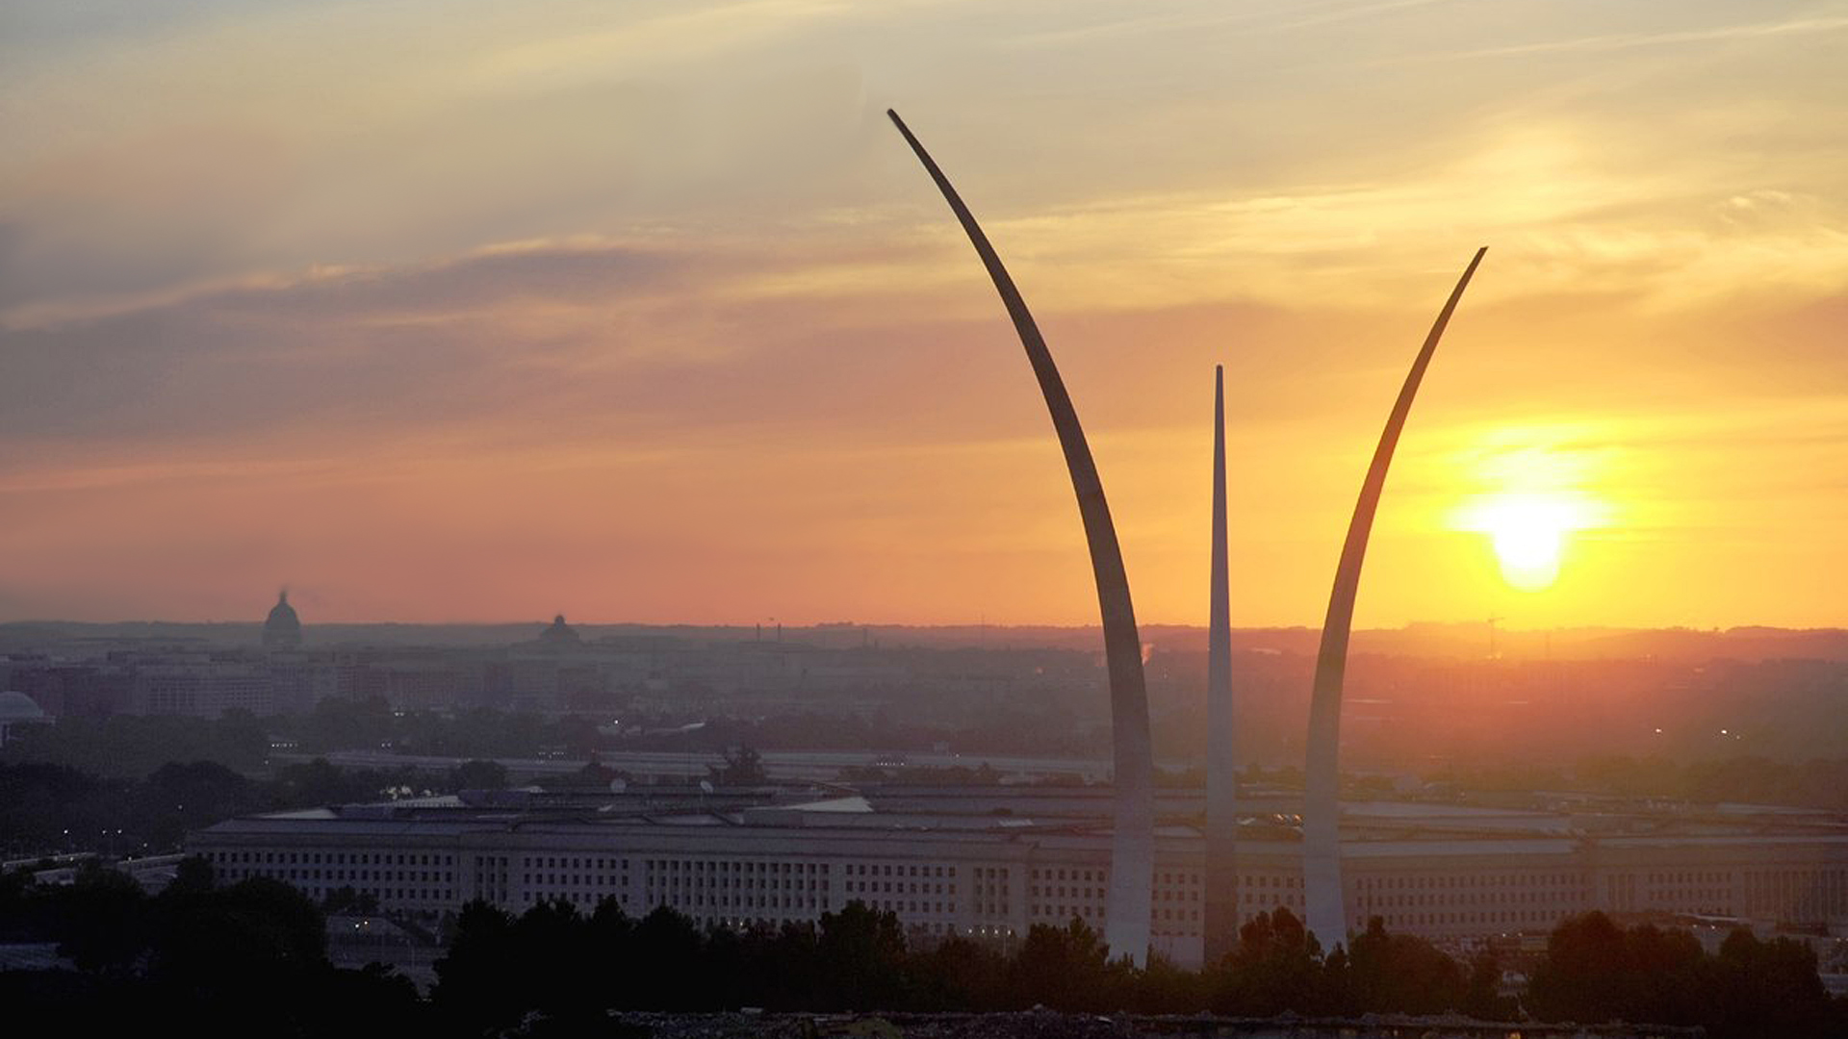
Memorials, Monuments and More
Washington D.C.

Slide 2
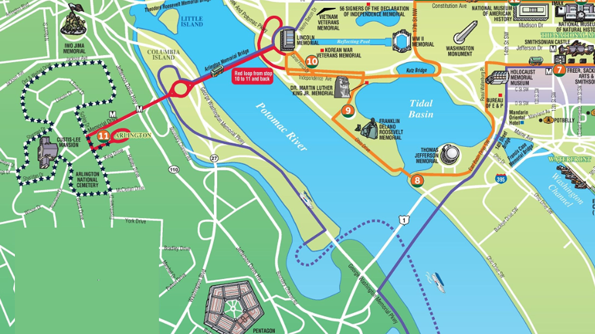
Air Force
Memorial

Slide 3
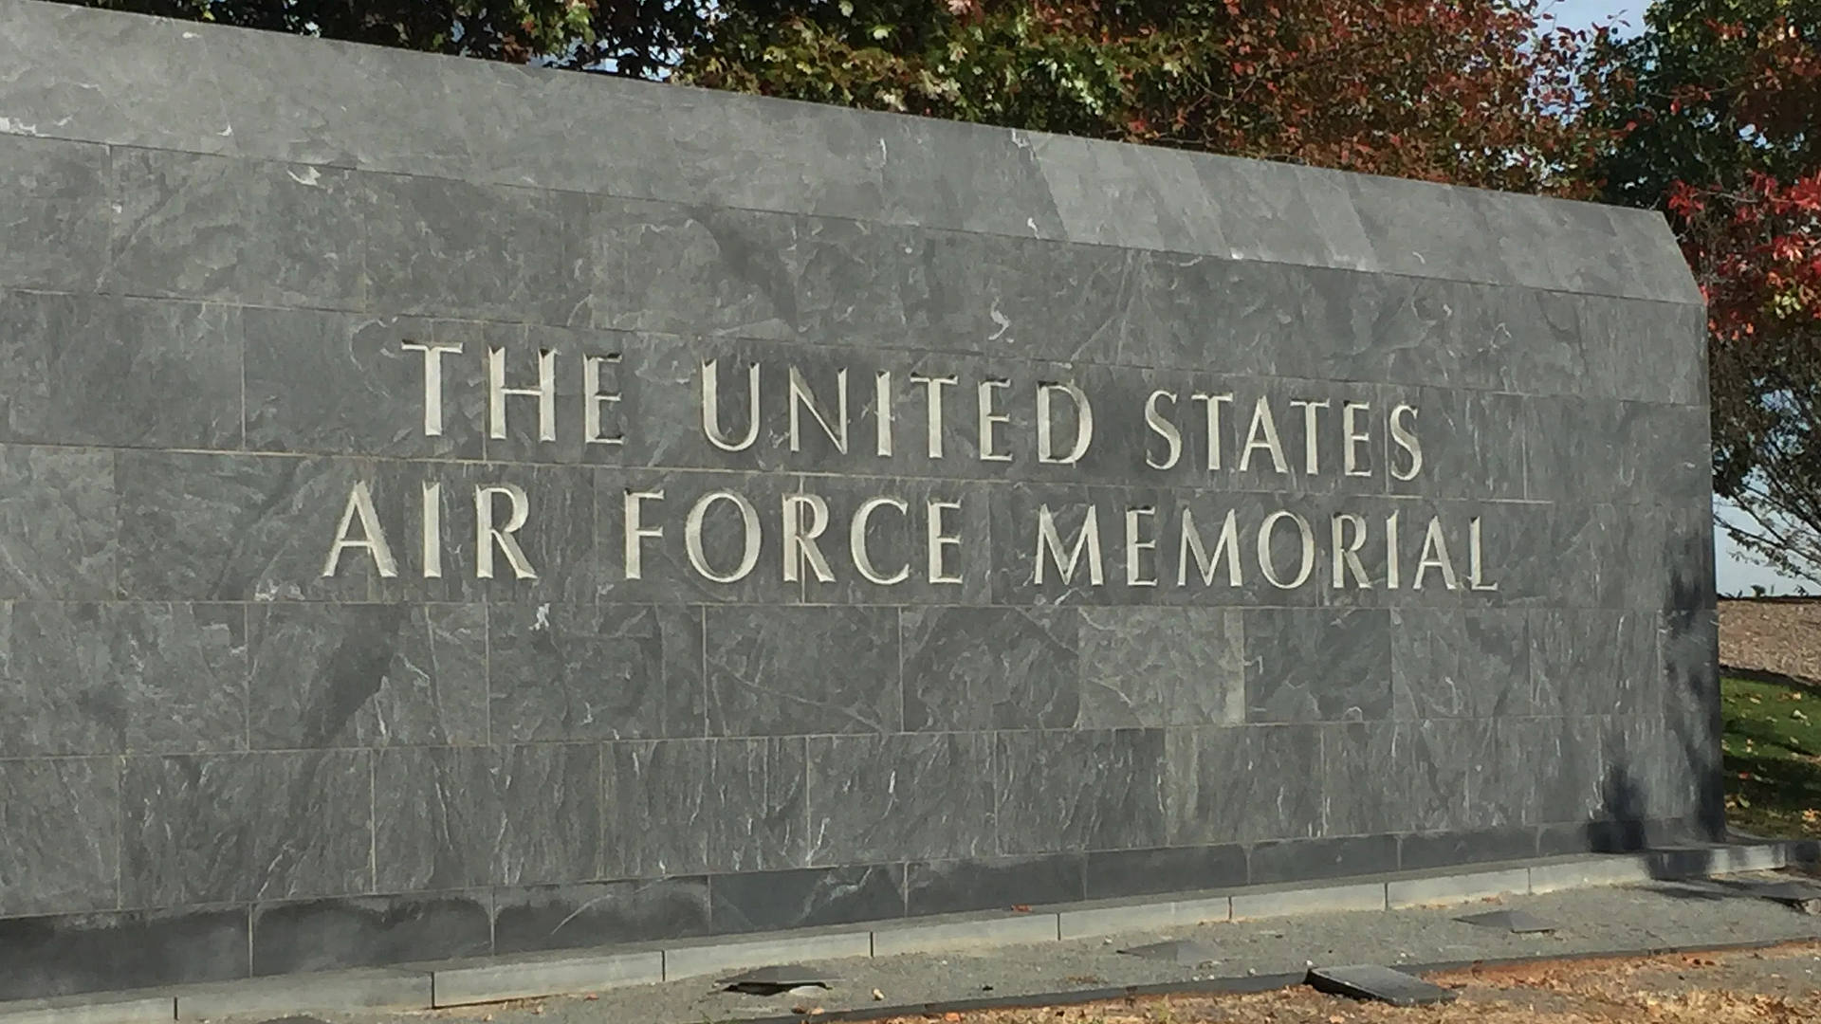

Slide 4
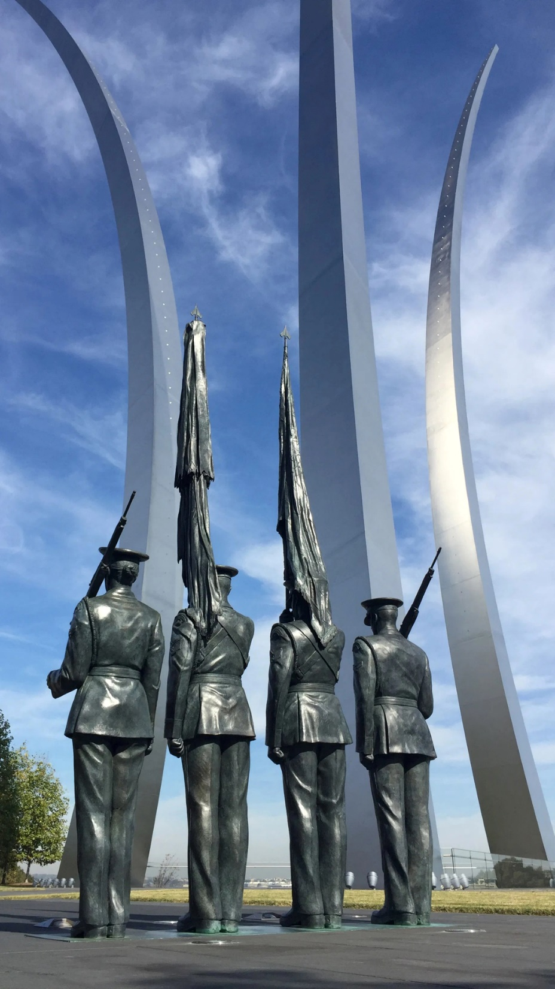
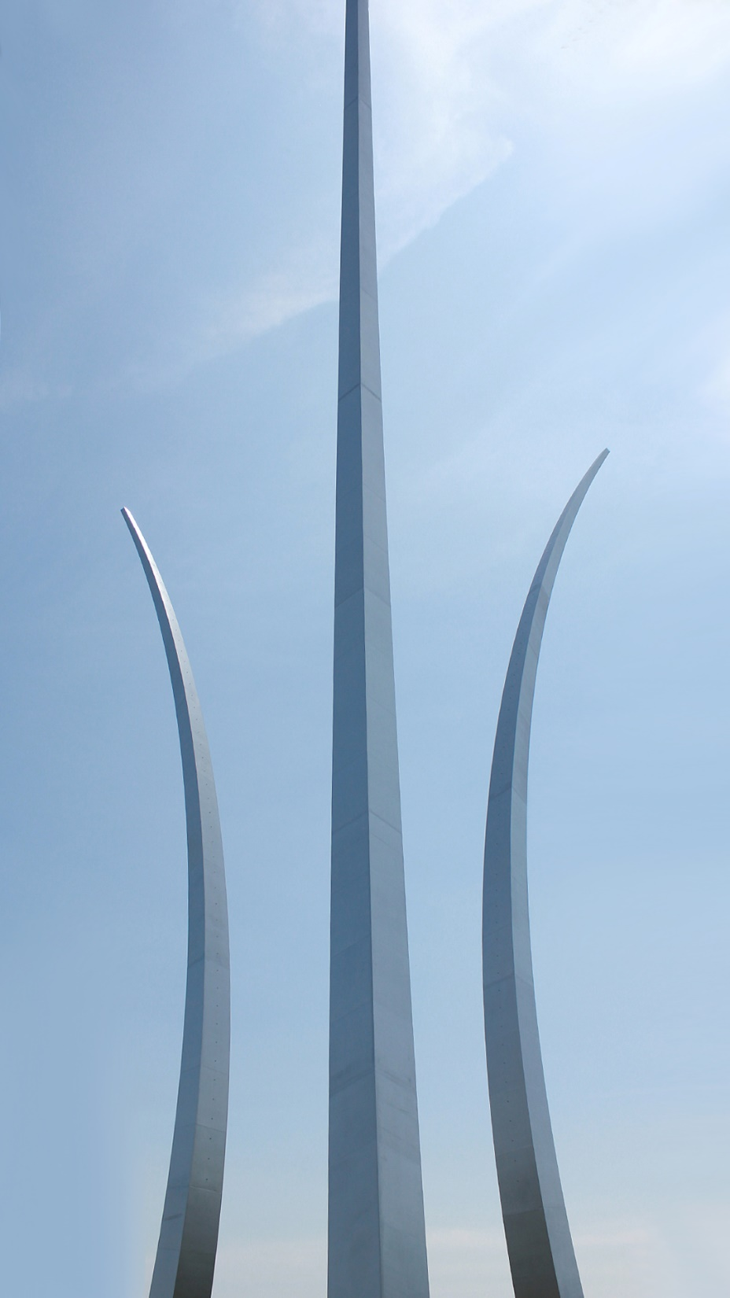
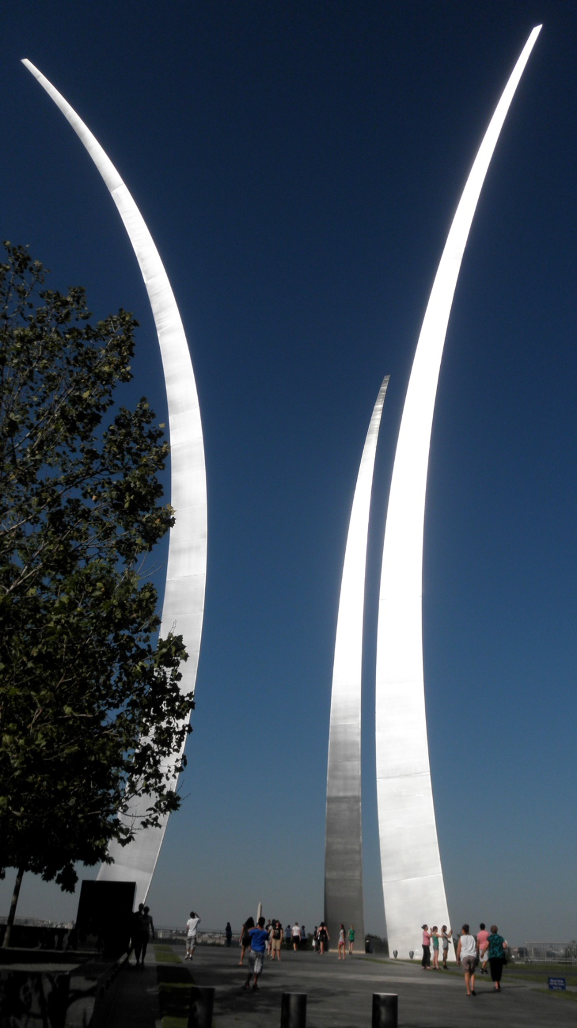

Slide 5
Air Force
Memorial

Slide 6
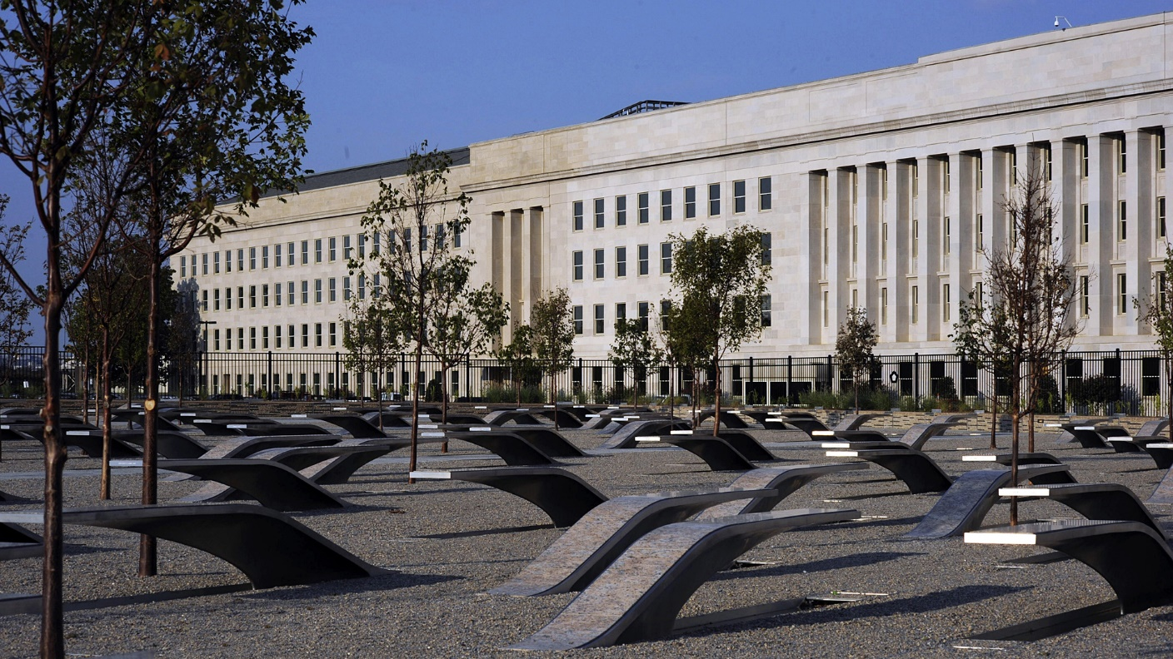

Slide 7
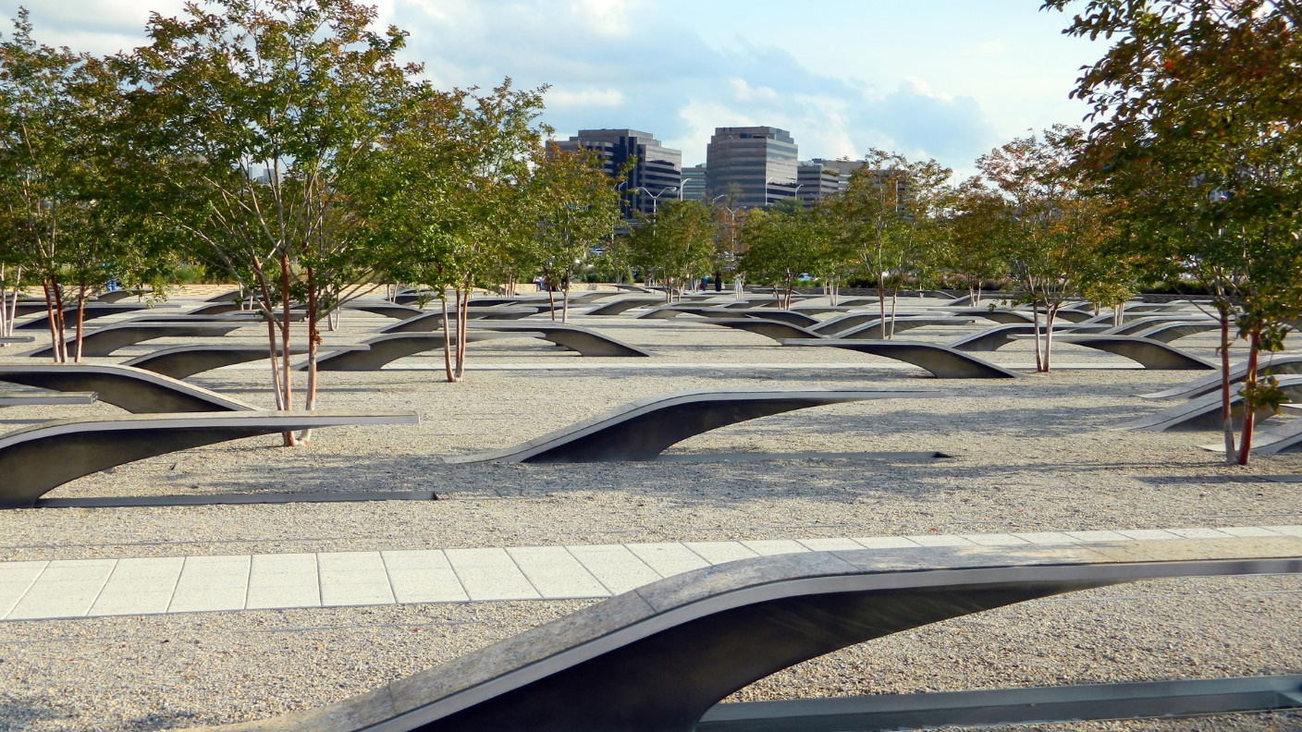
Pentagon Memorial

Slide 8
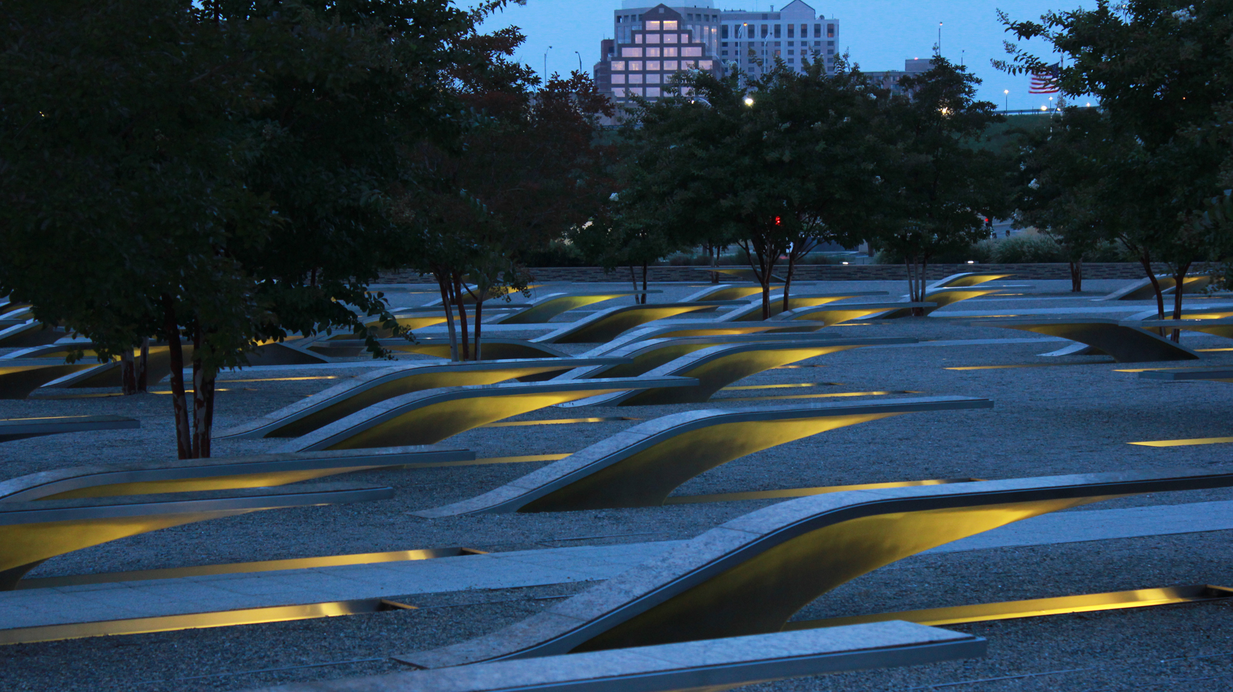

Slide 10
Air Force
Memorial

Slide 11
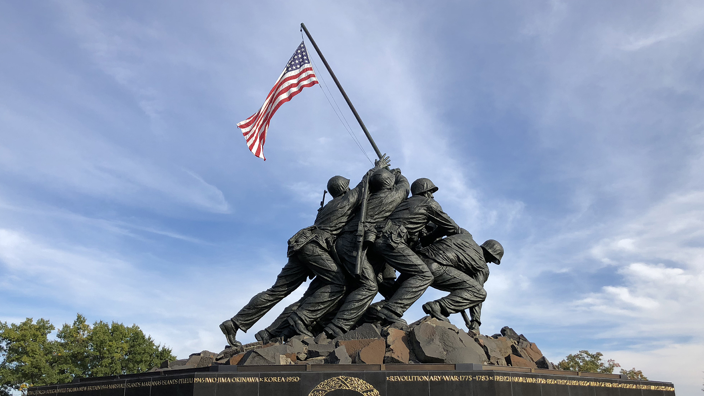
Marine Corps
War Memorial

Slide 12
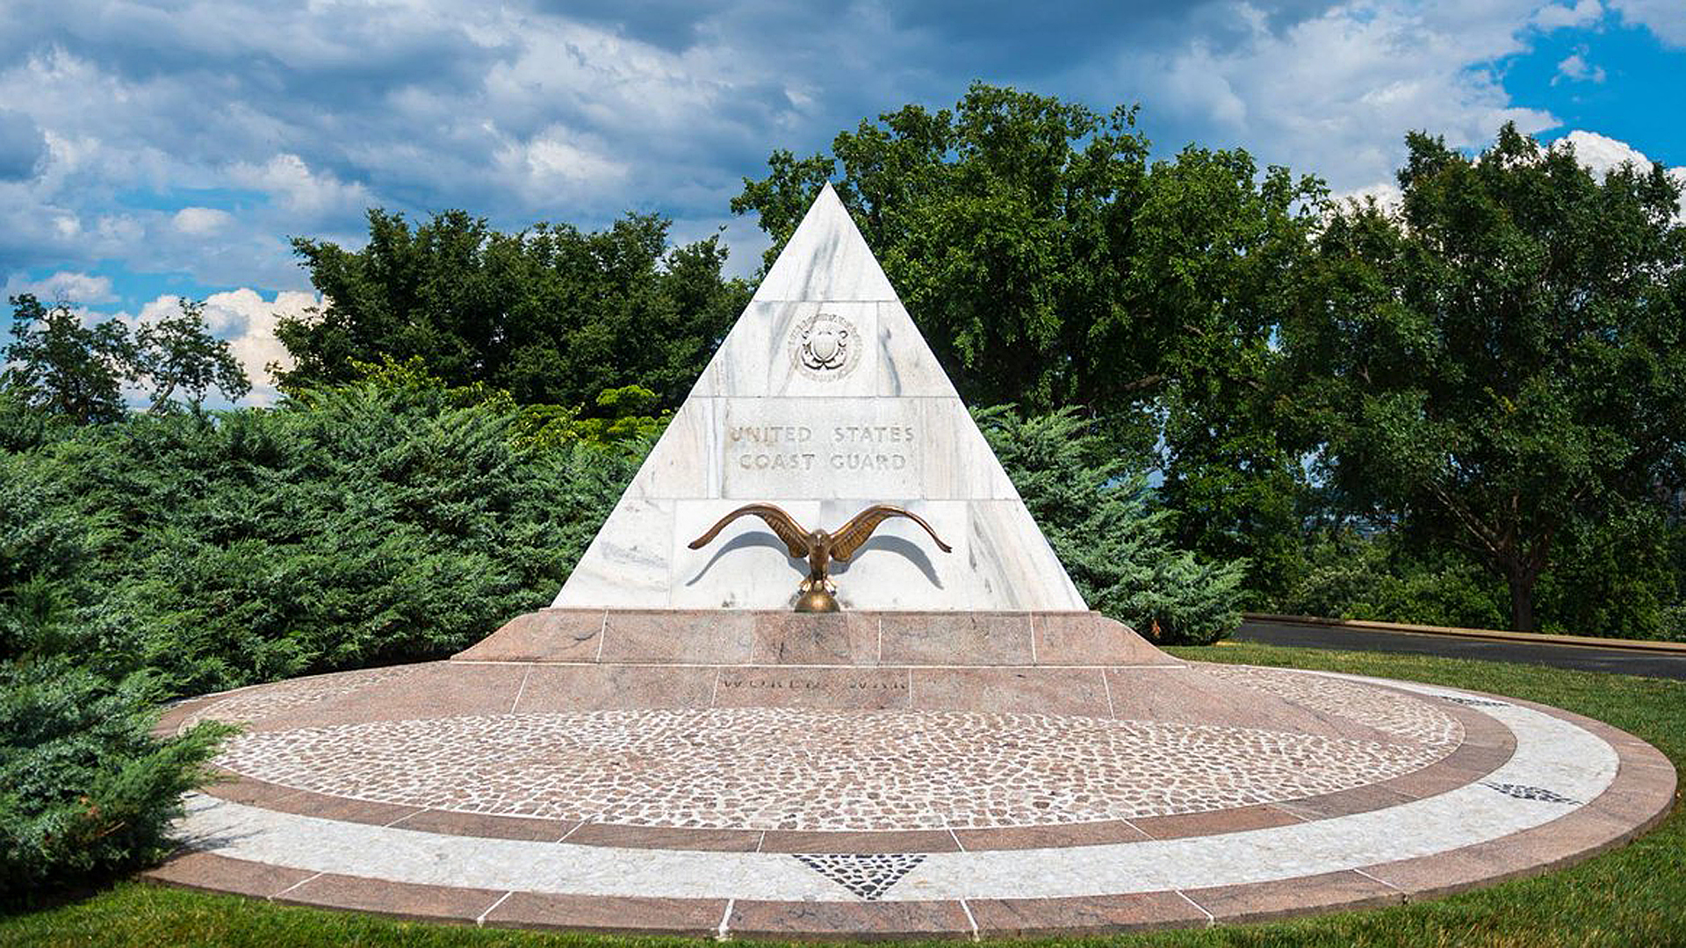

Slide 13
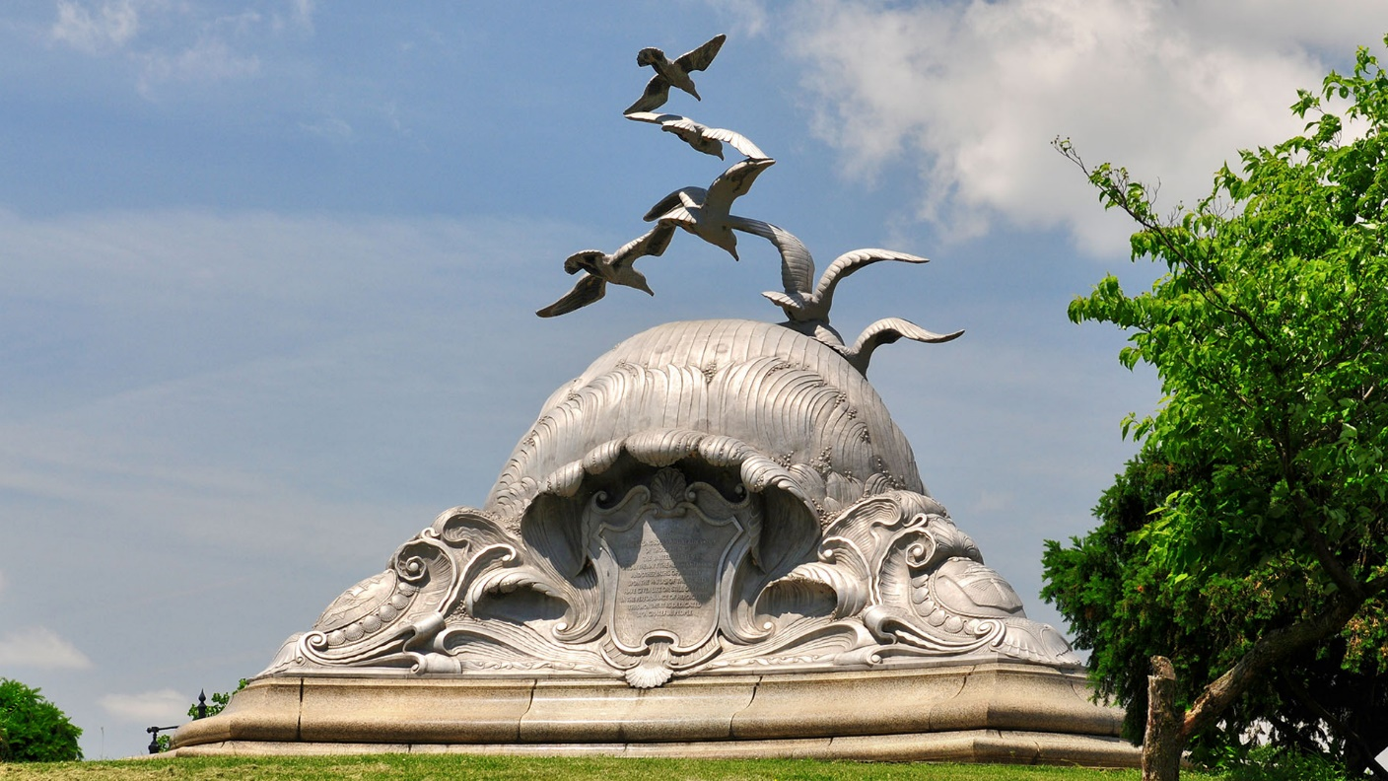
Navy Merchant
Marine Memorial

Slide 14
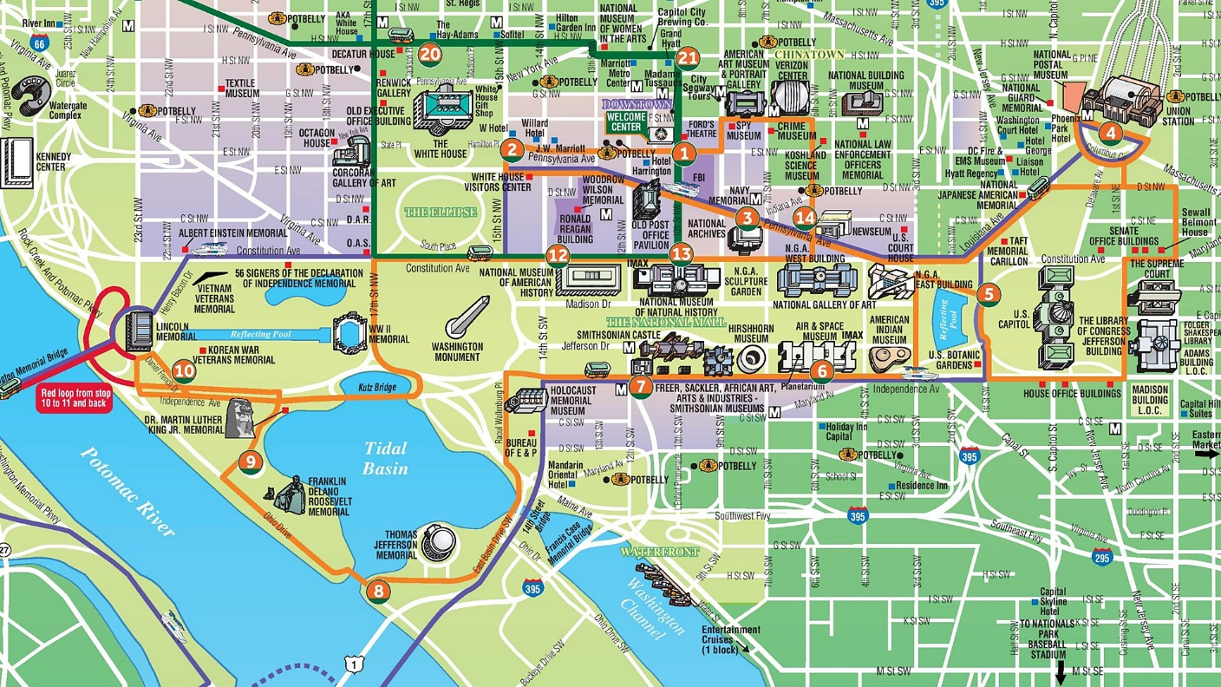
Smithsonian Museums on the Mall

Slide 15
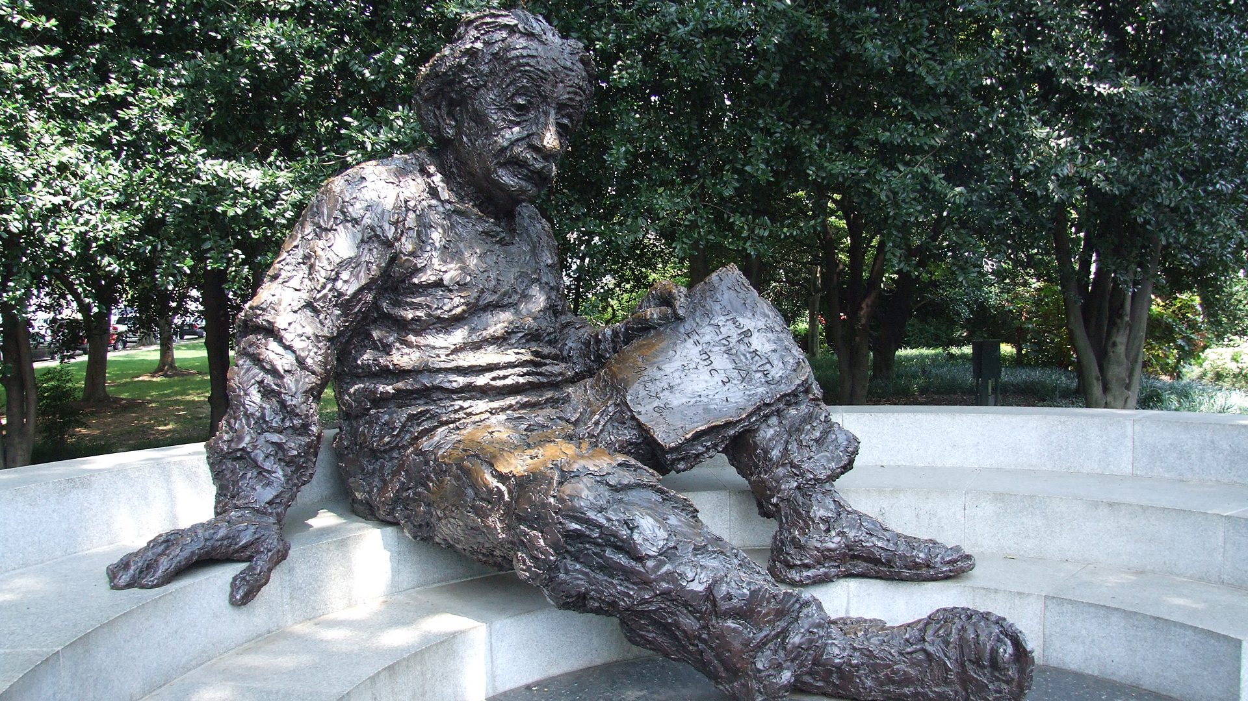
Albert Einstein Memorial

Slide 16
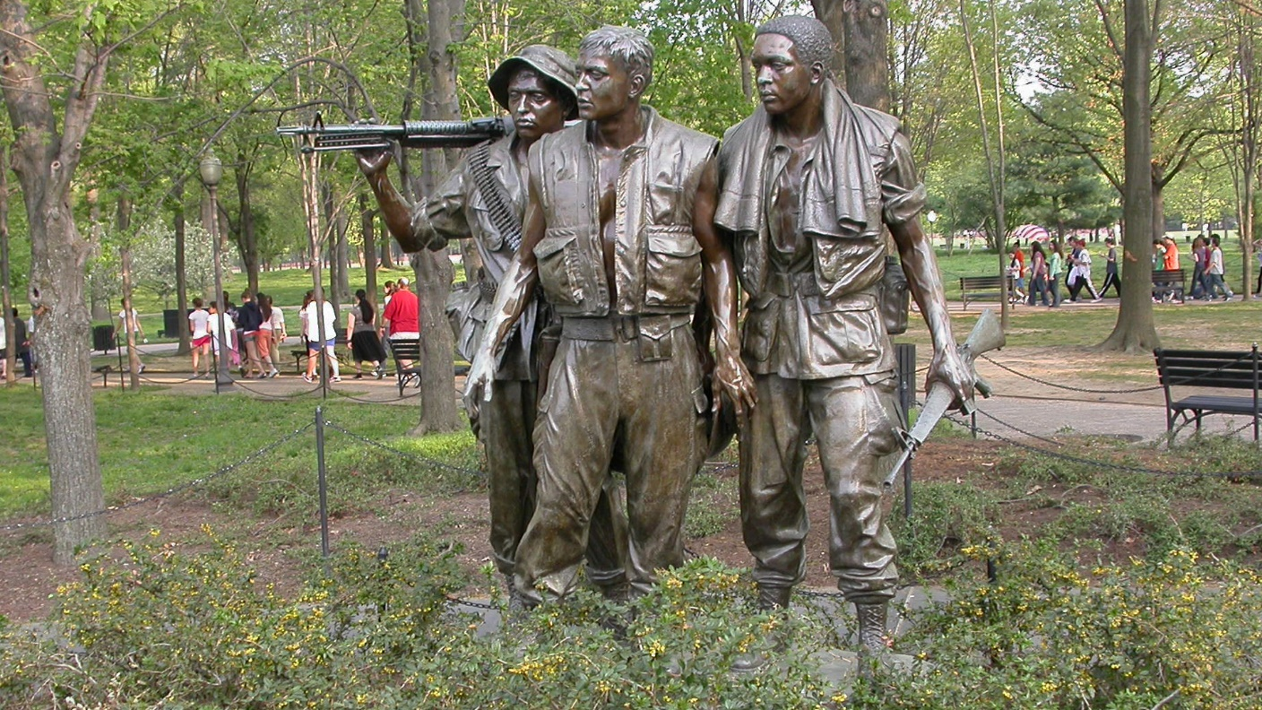

Slide 17
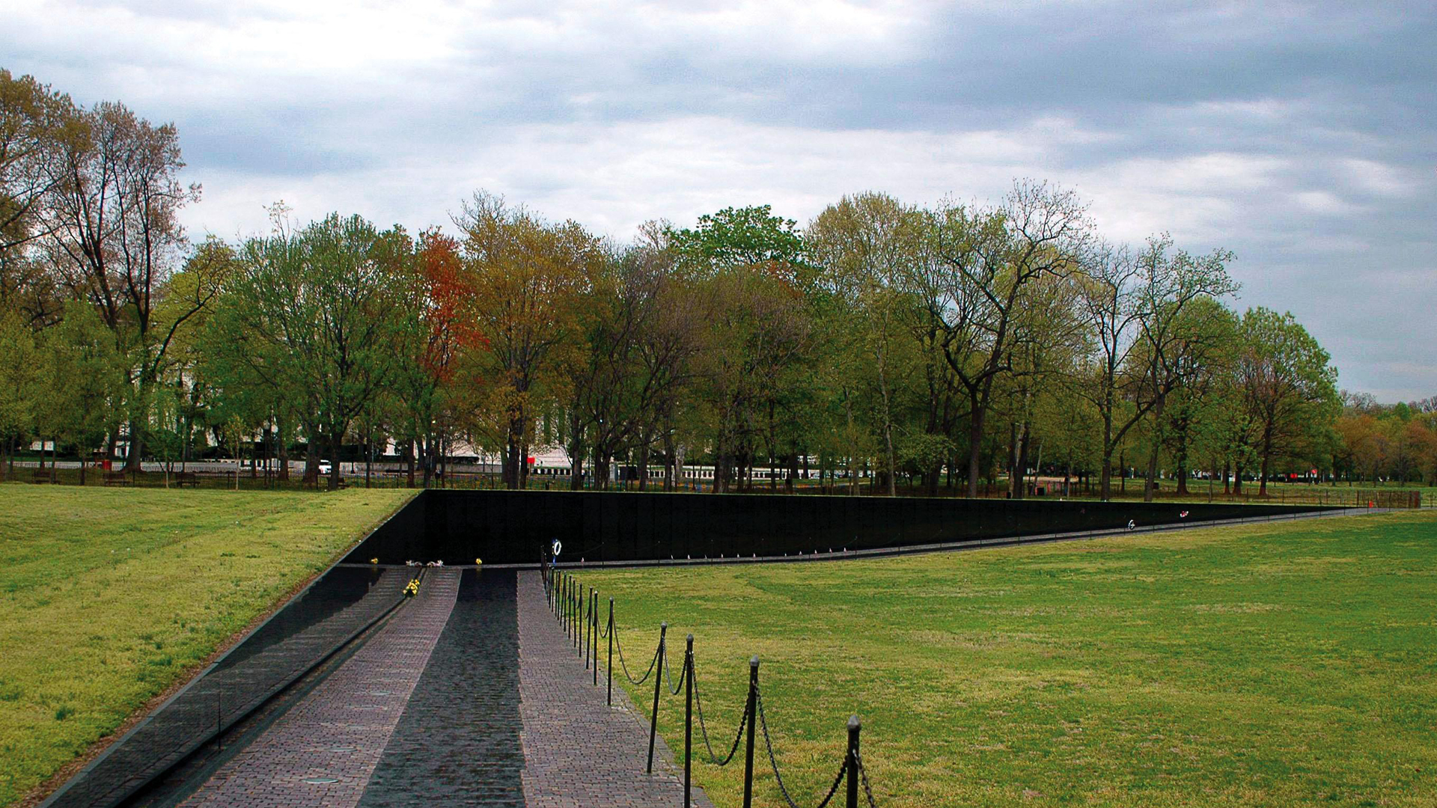

Slide 18
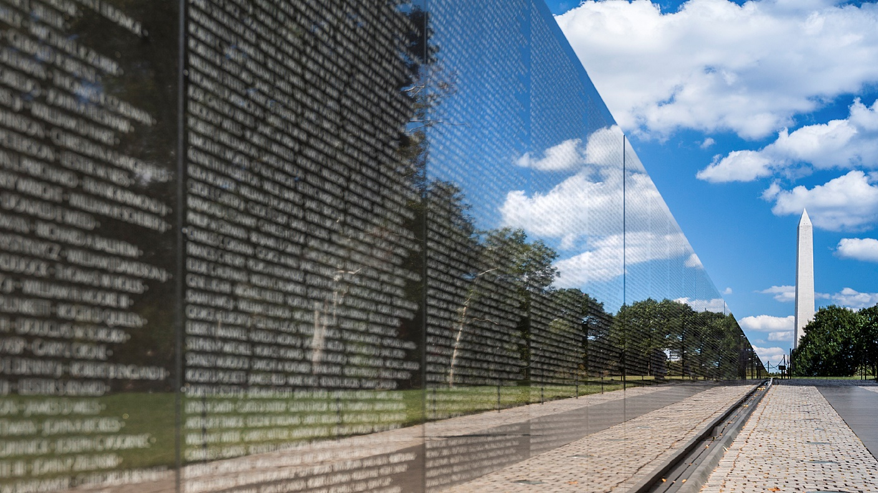
Vietnam Veterans Memorial

Slide 19
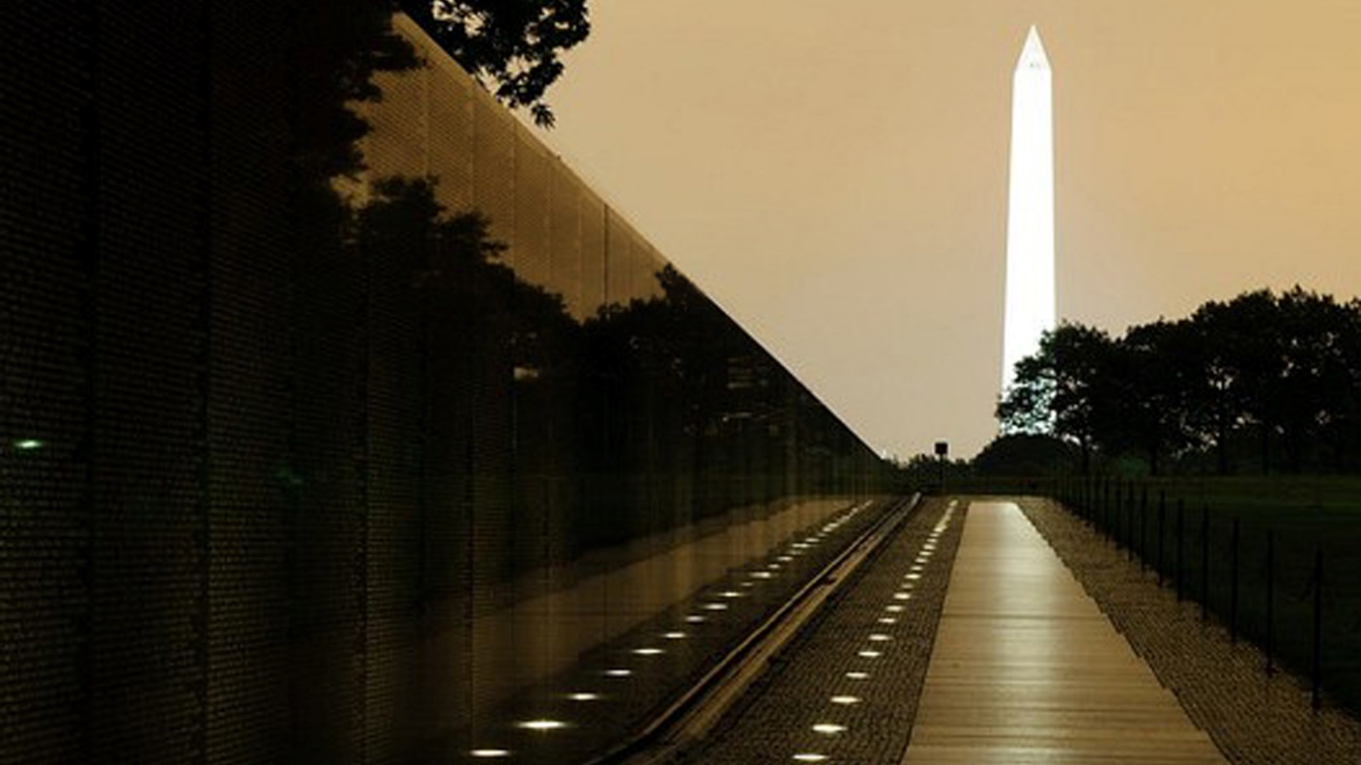

Slide 20
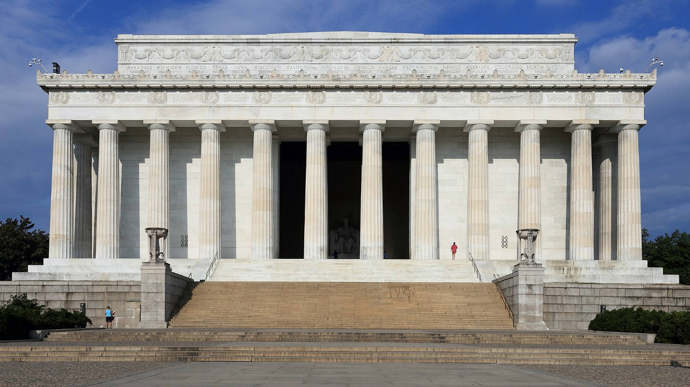
Lincoln Memorial

Slide 21
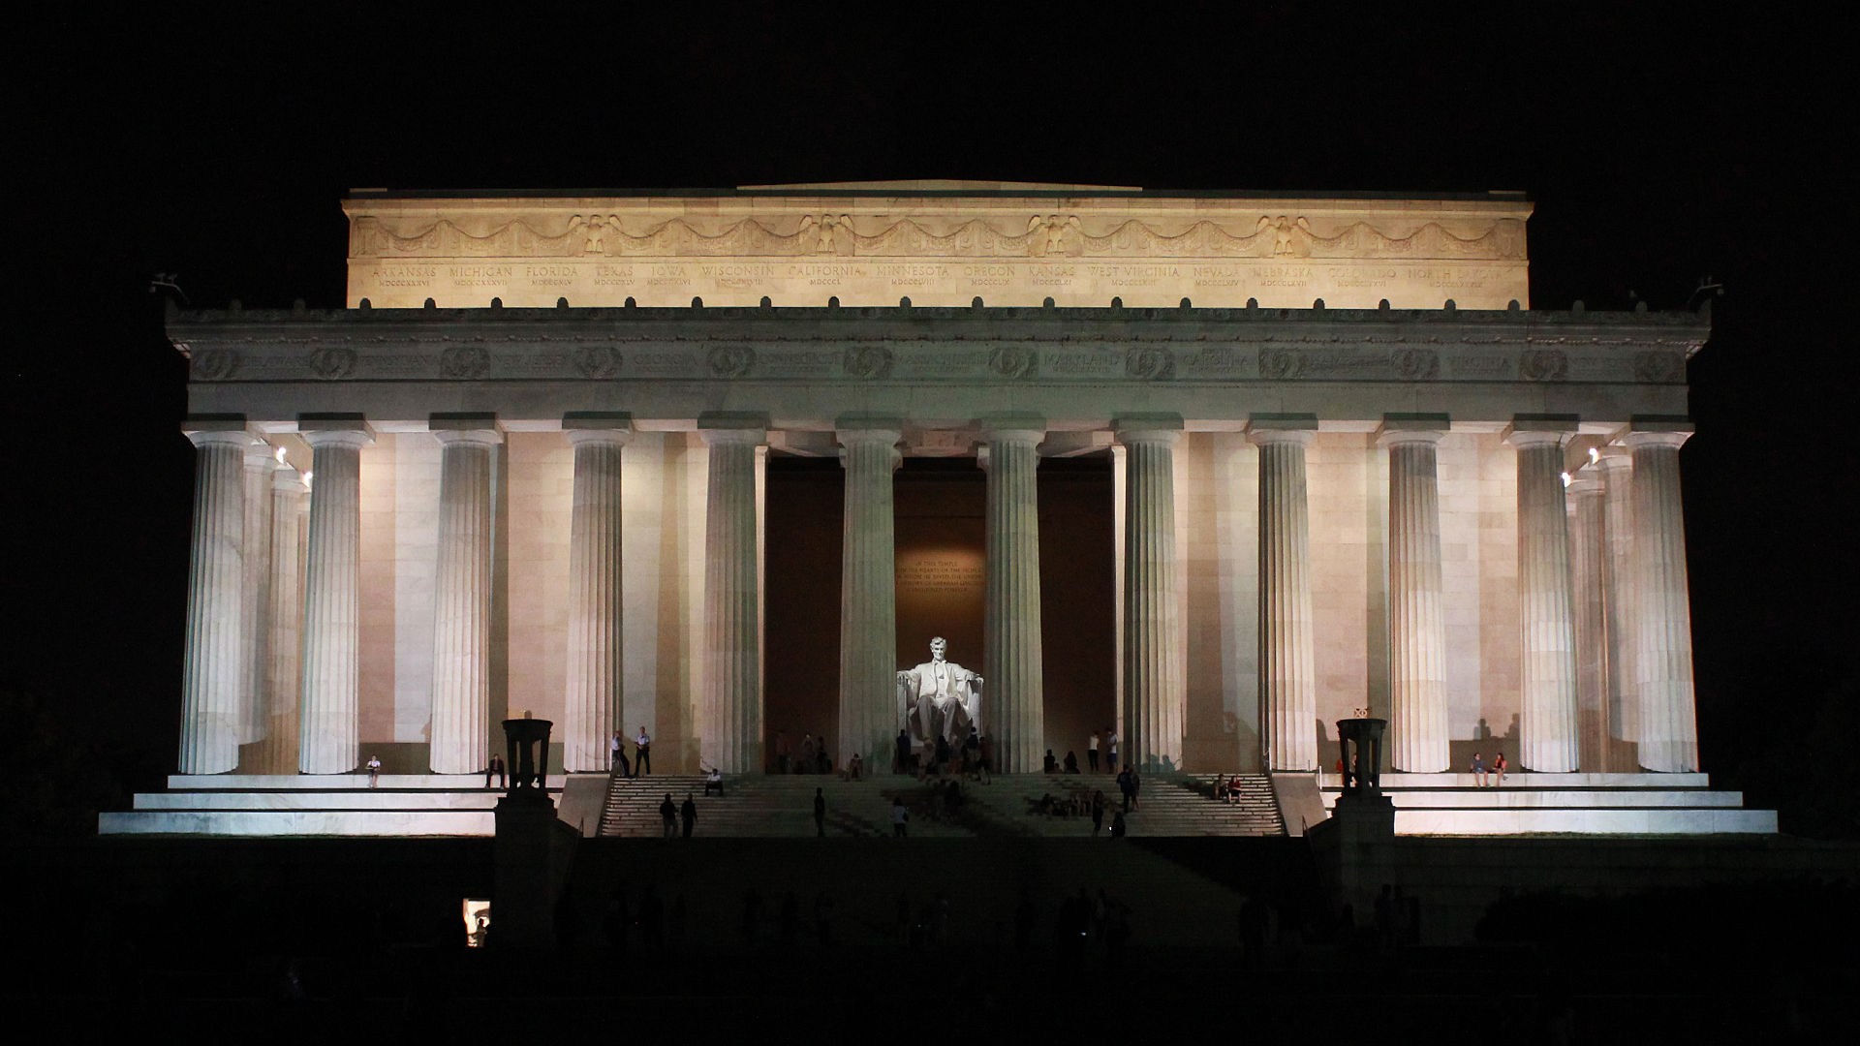

Slide 22
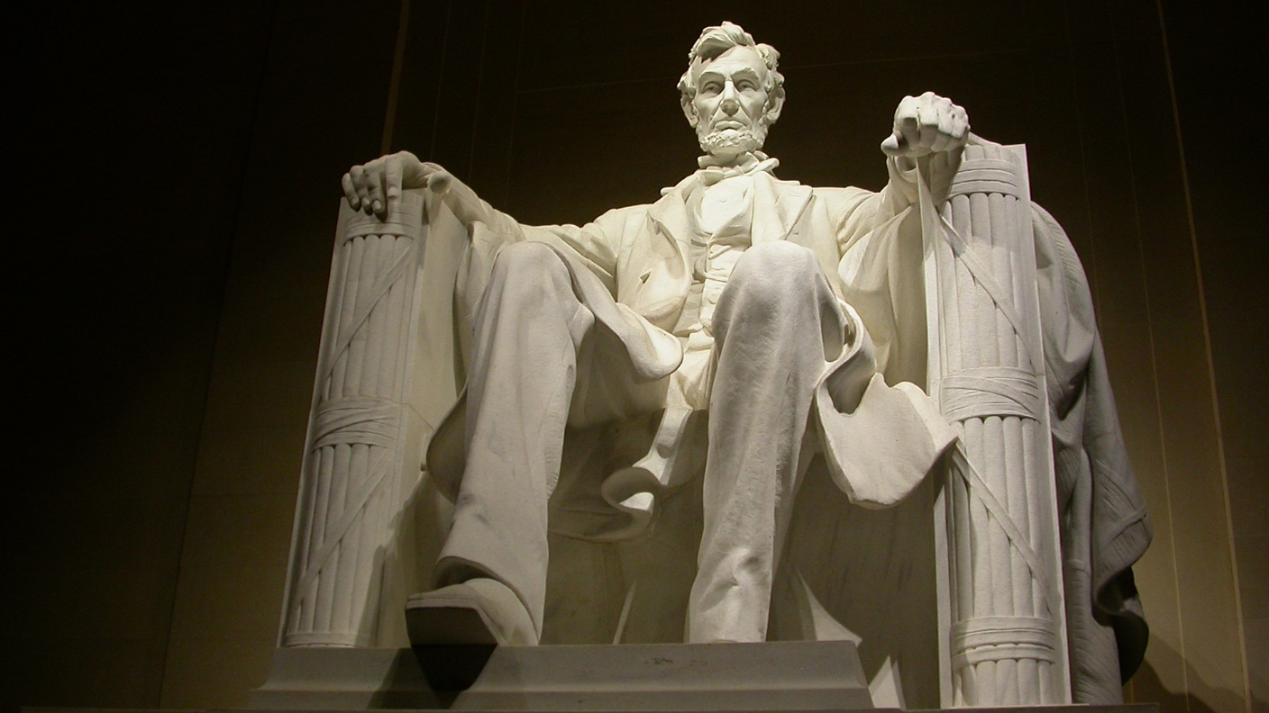

Slide 23
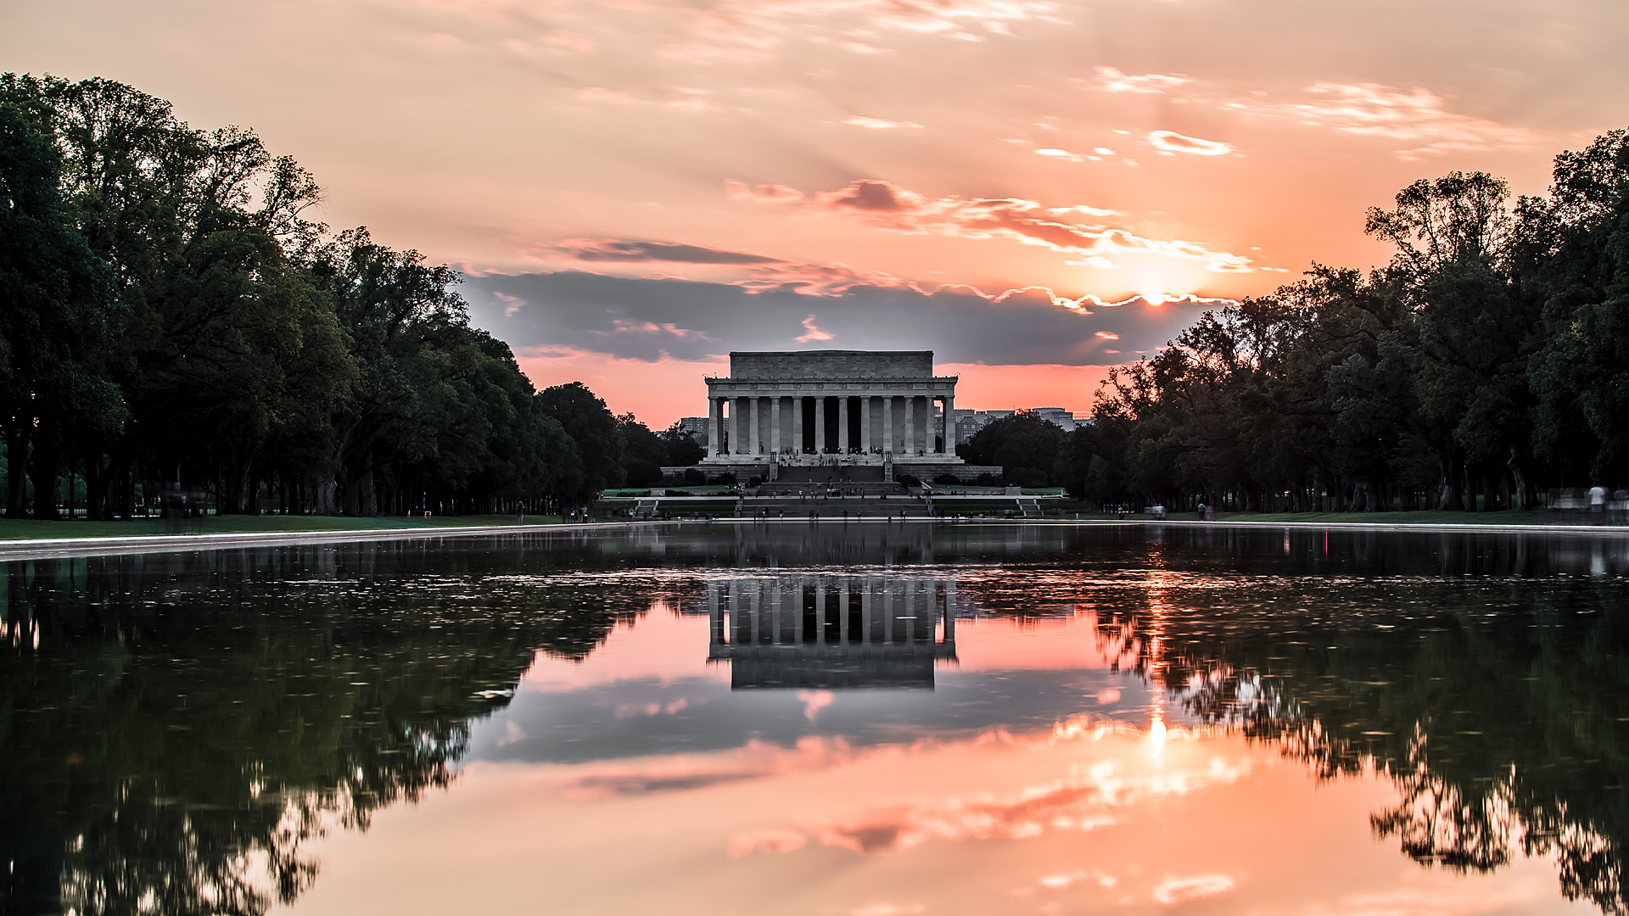

Slide 24
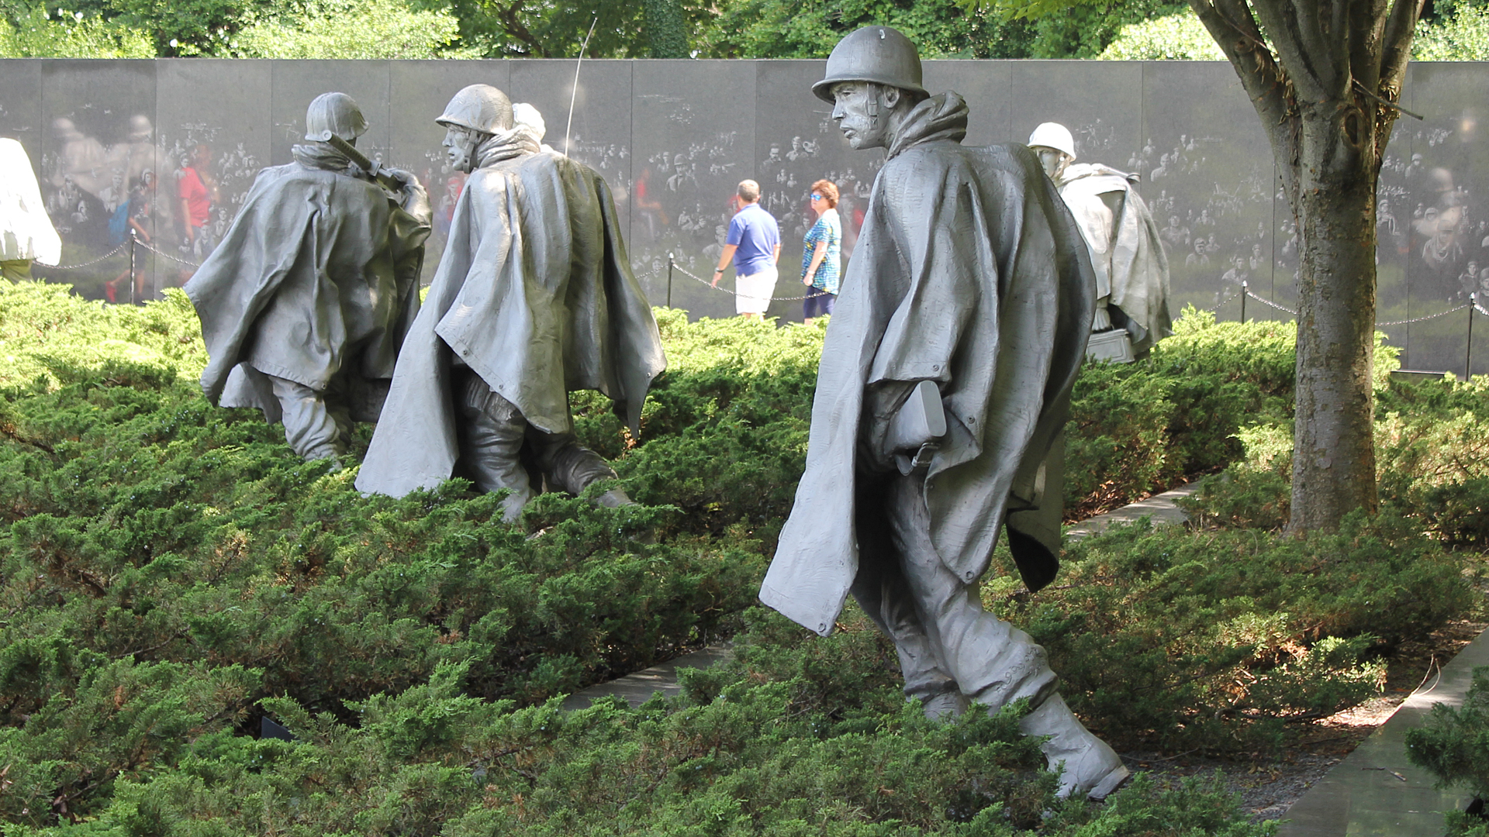
Korean War Veterans Memorial

Slide 25
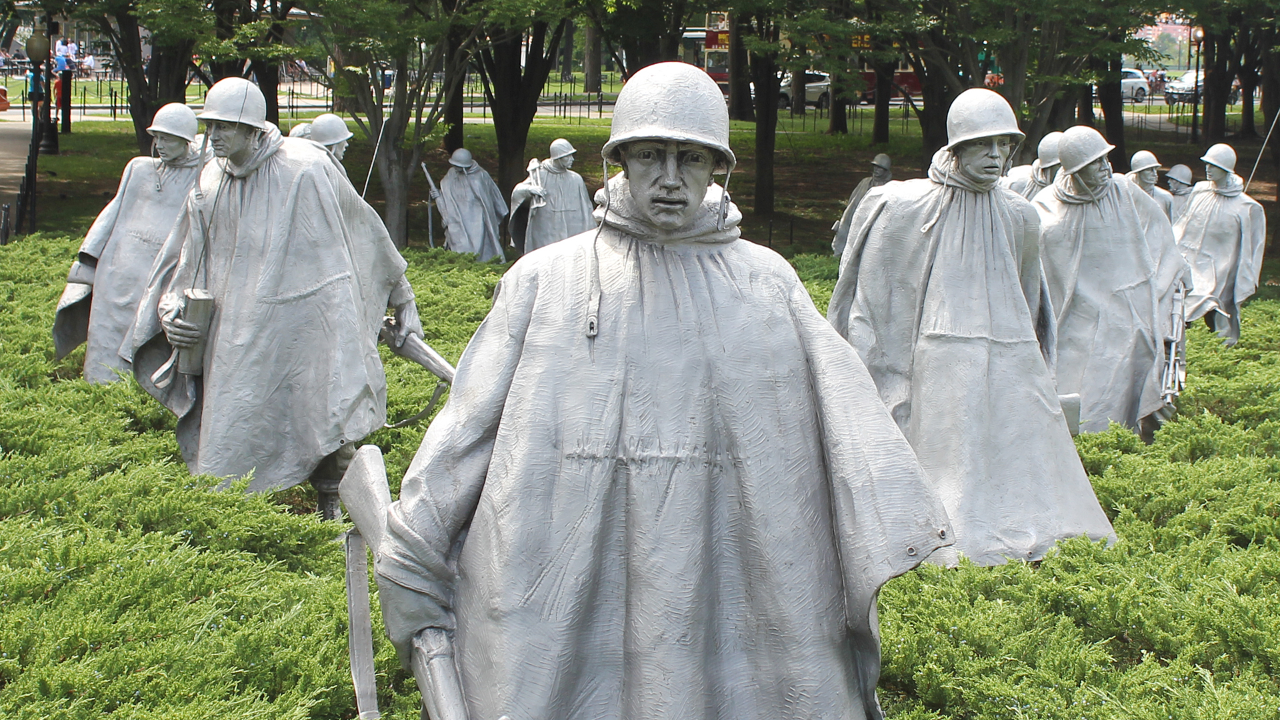

Slide 26
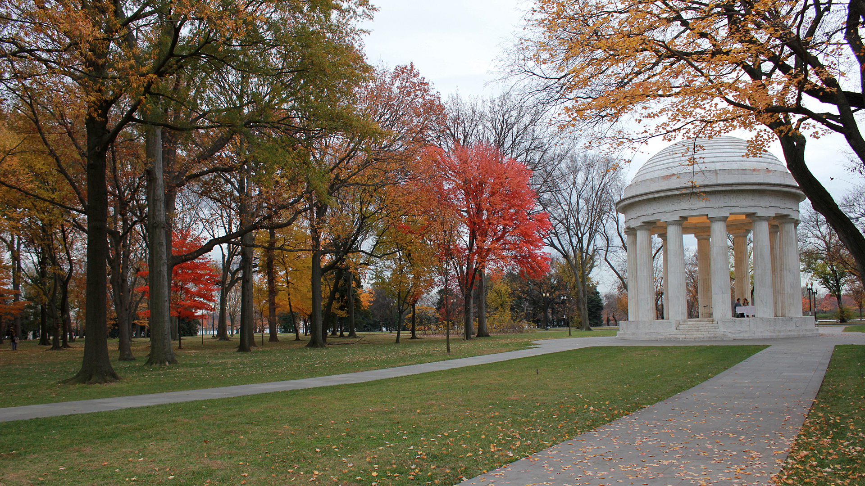
District of Columbia War Memorial

Slide 27
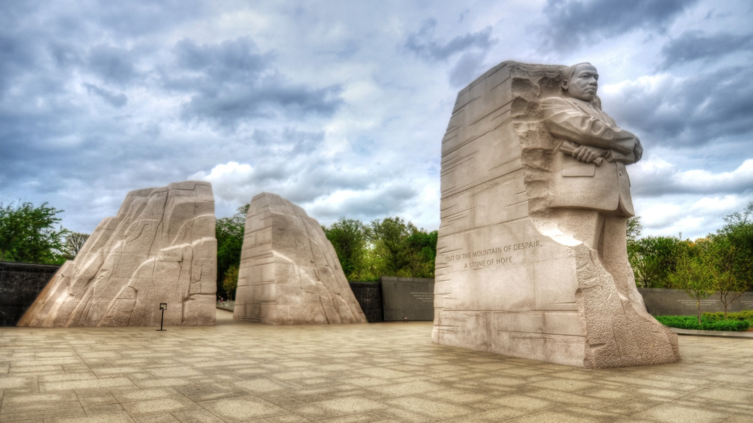
Martin Luther King Jr. Memorial

Slide 28
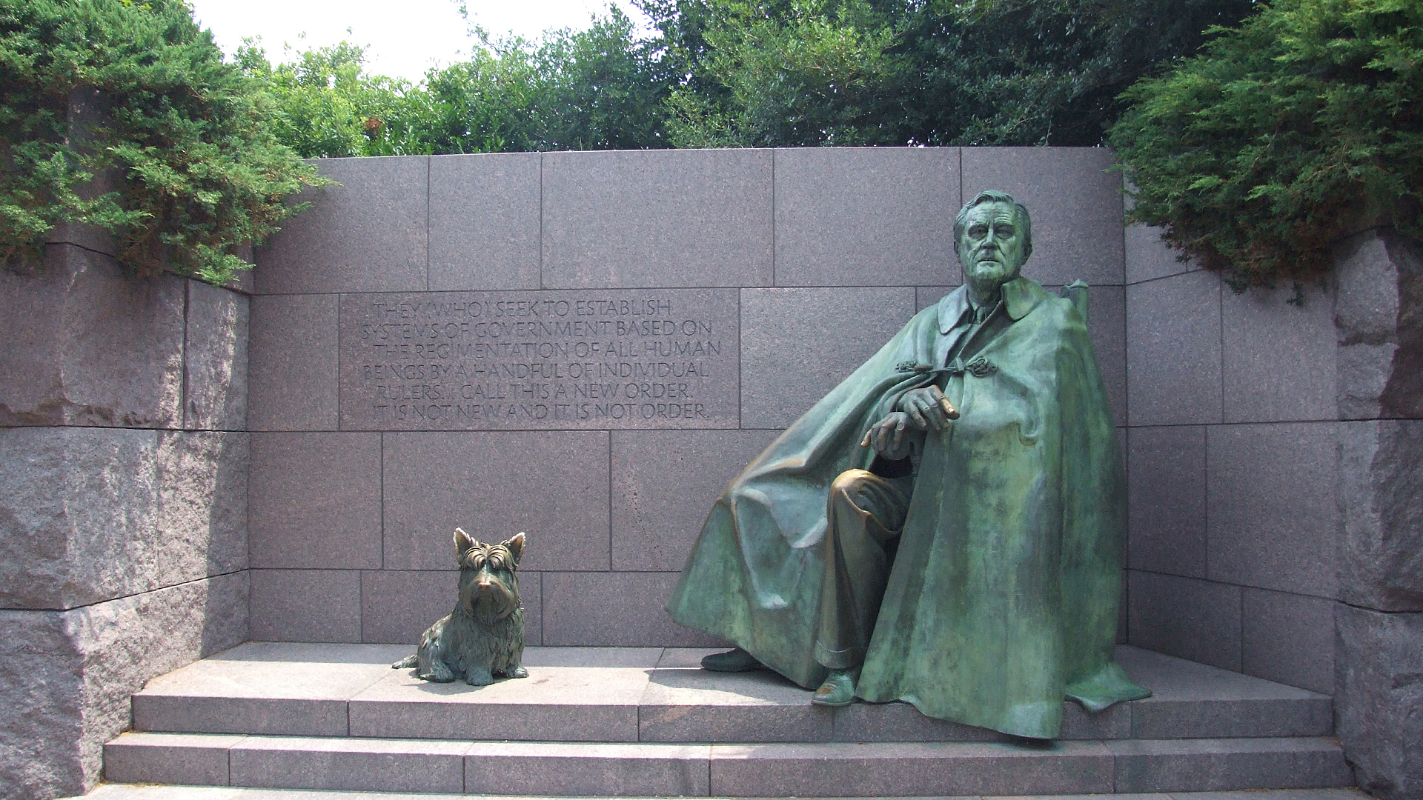
F.D.R. Memorial

Slide 29
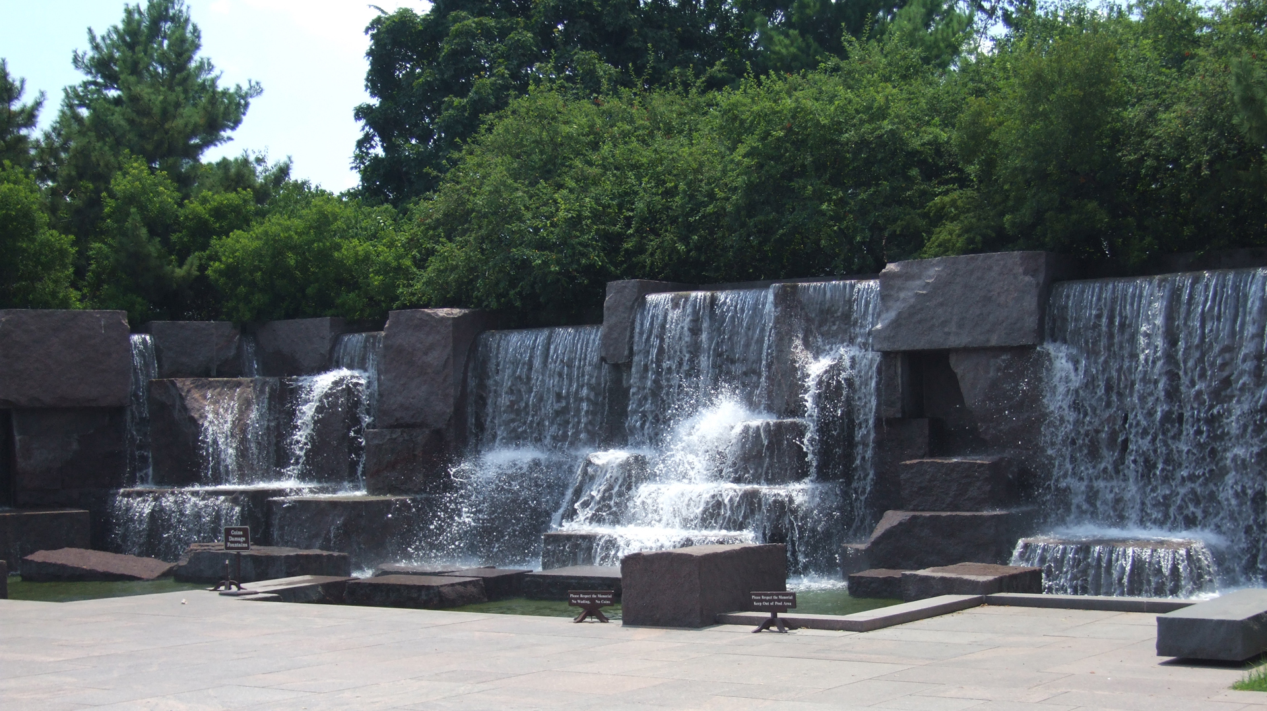

Slide 30
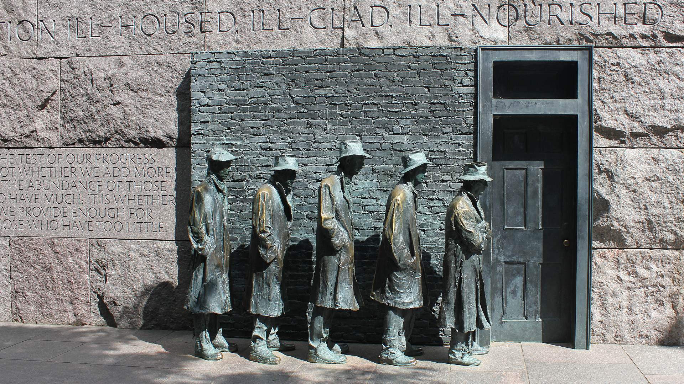

Slide 31
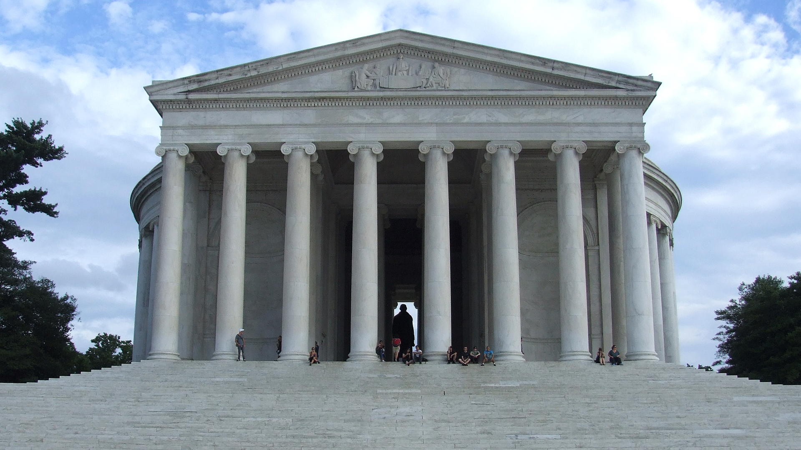
Jefferson Memorial

Slide 32
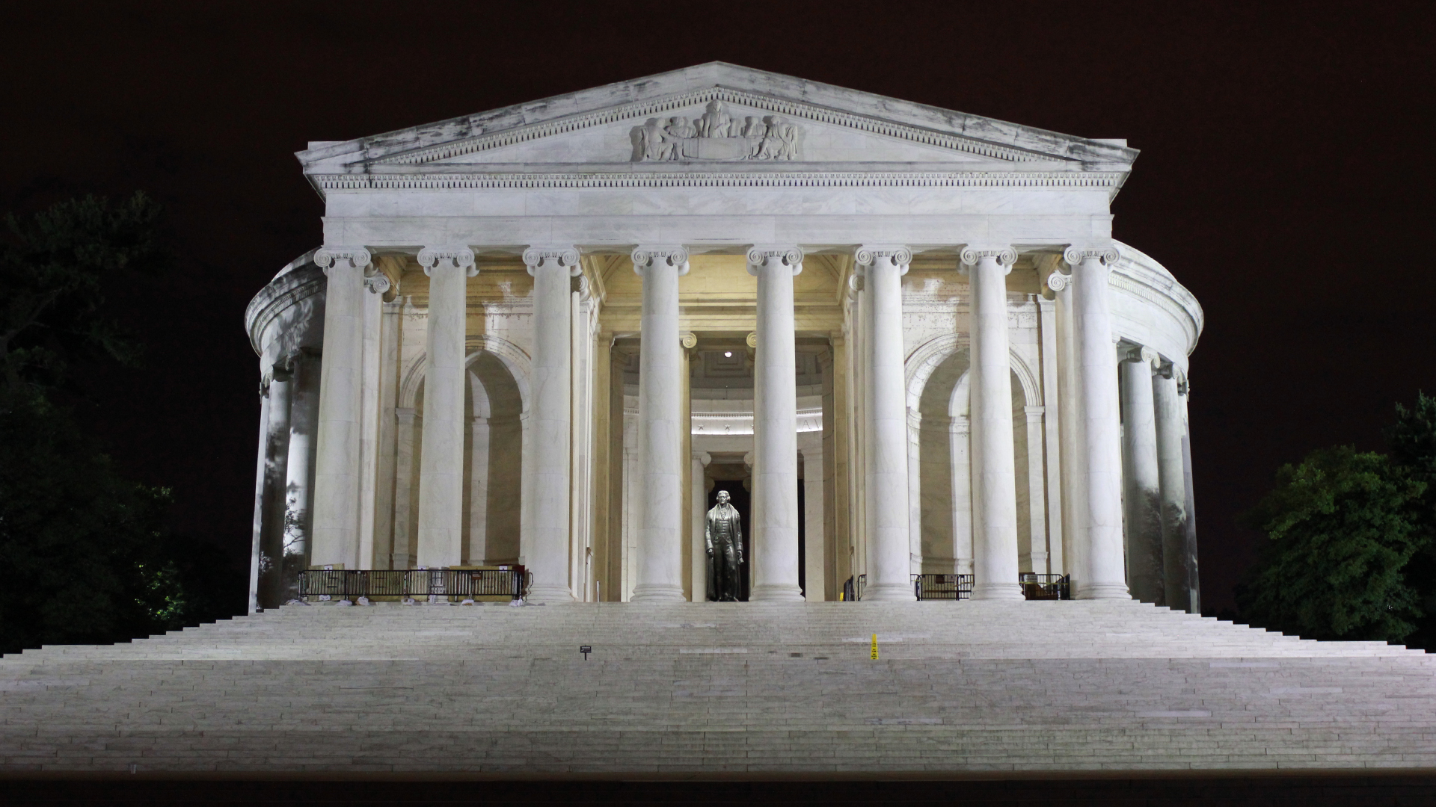

Slide 33
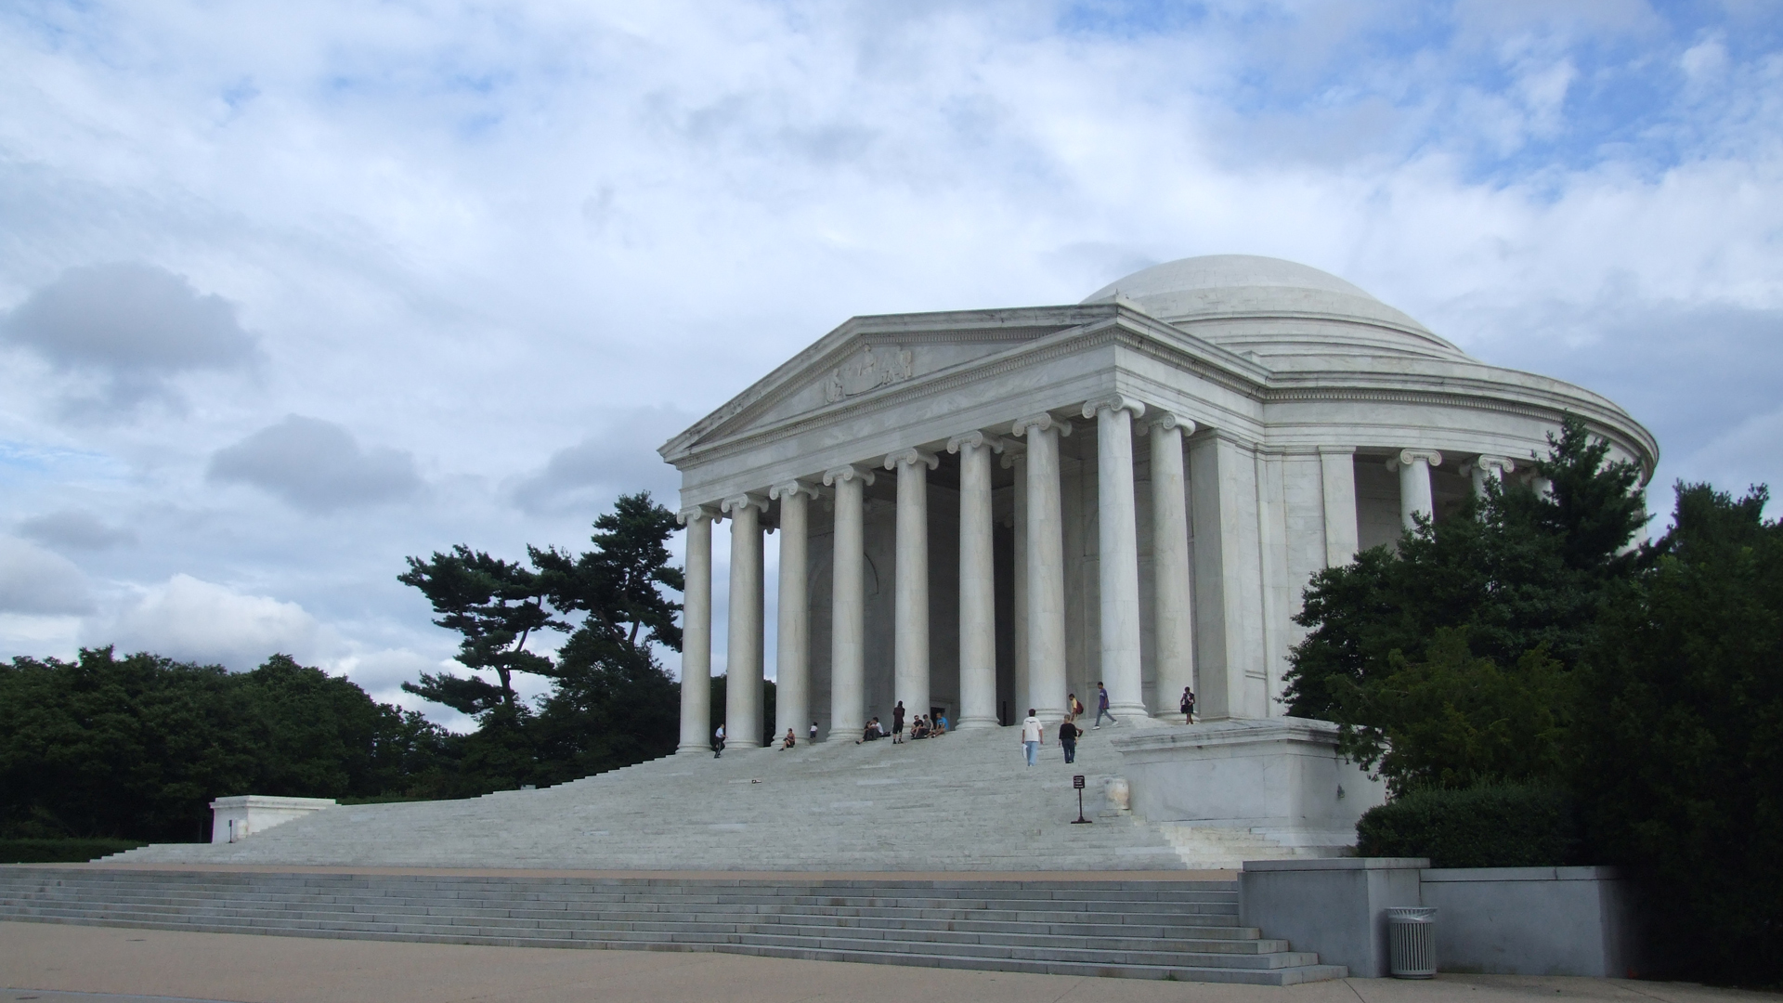

Slide 34
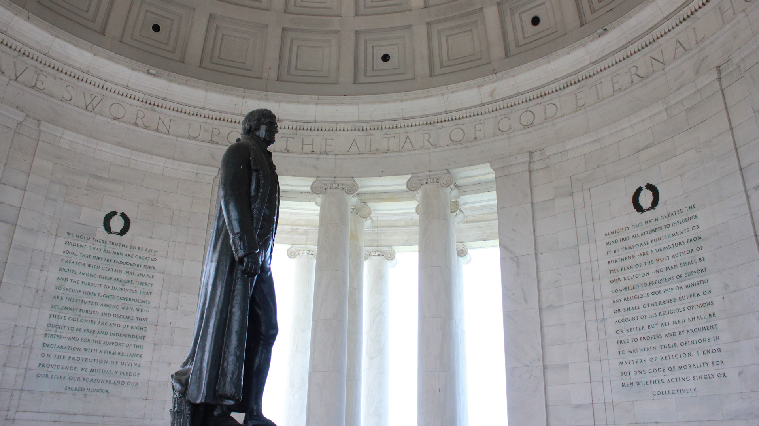

Slide 35
Smithsonian Museums on the Mall

Slide 36
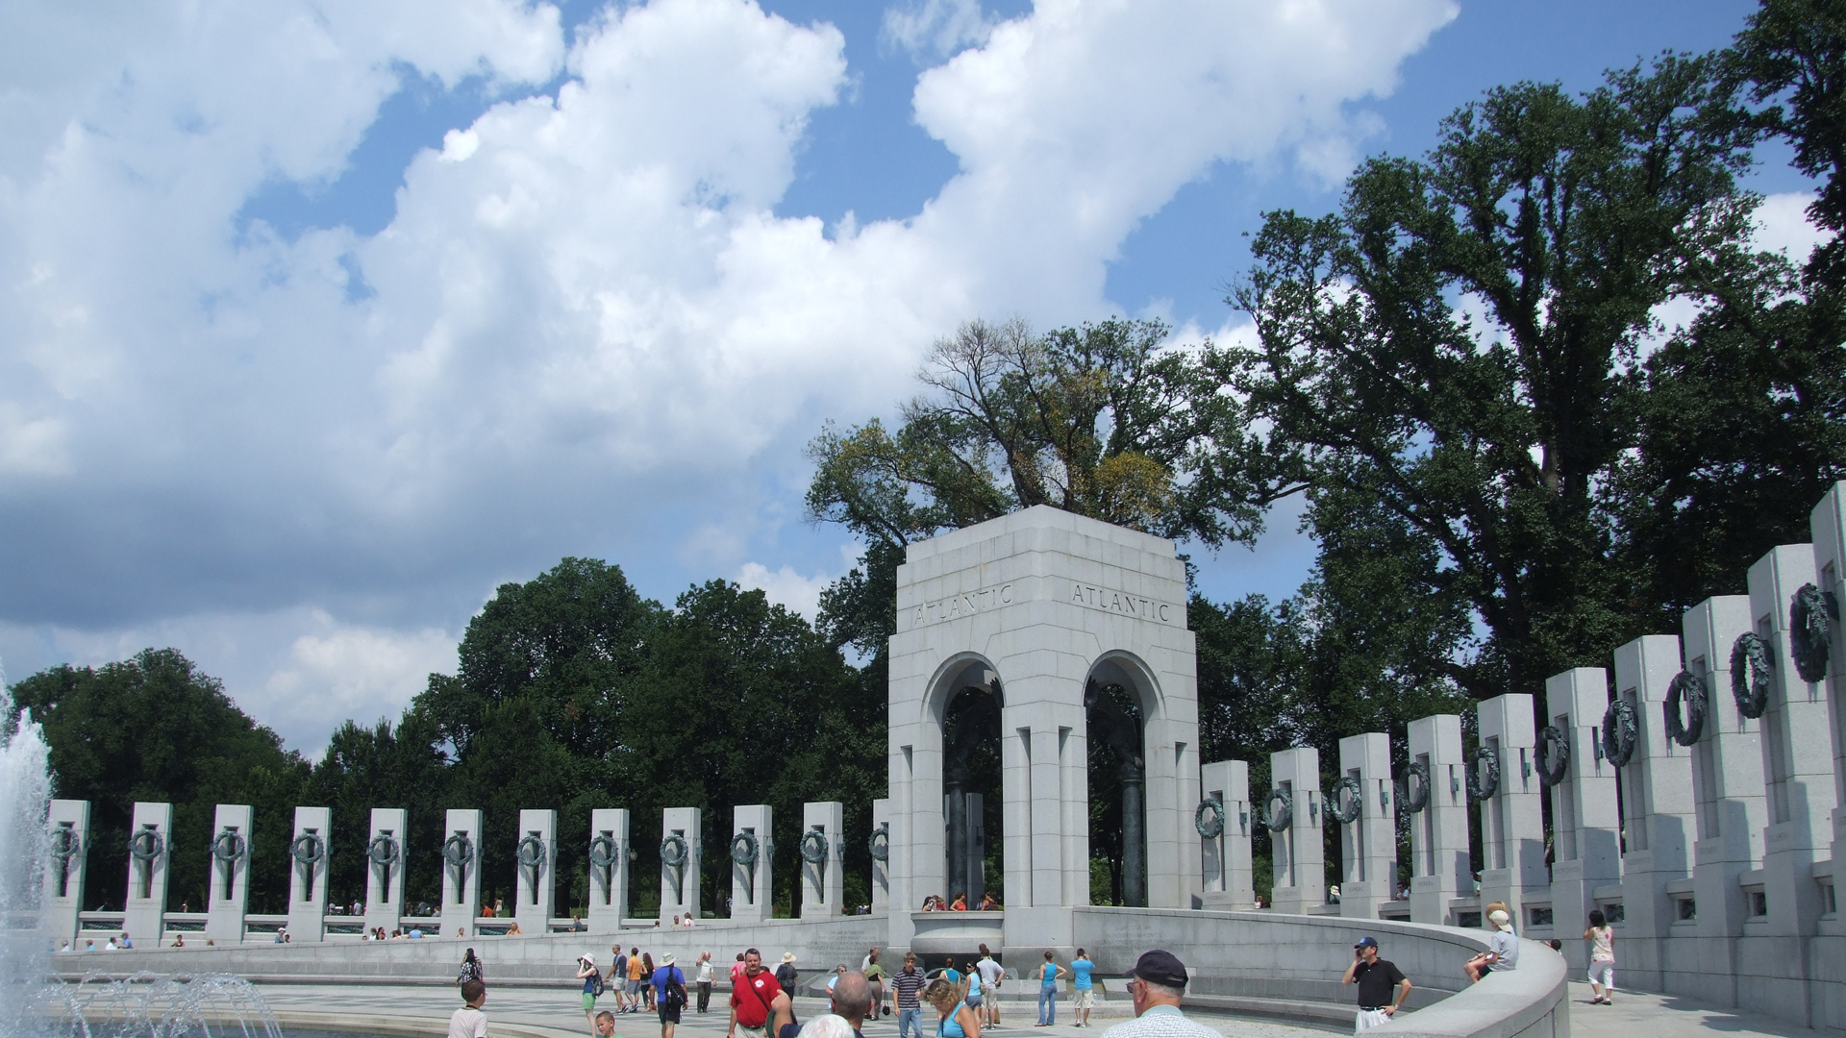
World War II Veterans Memorial

Slide 37
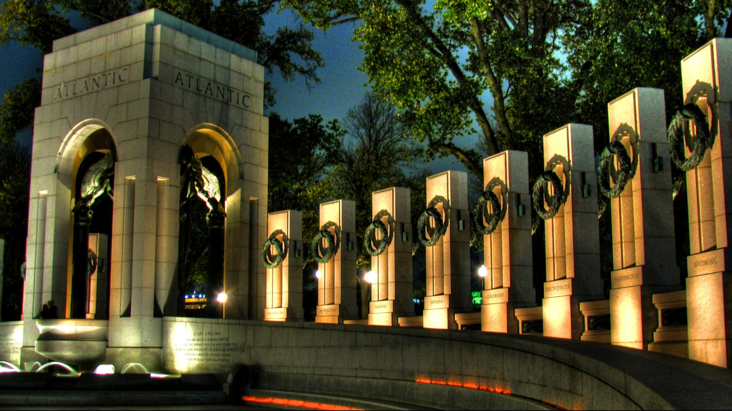

Slide 38
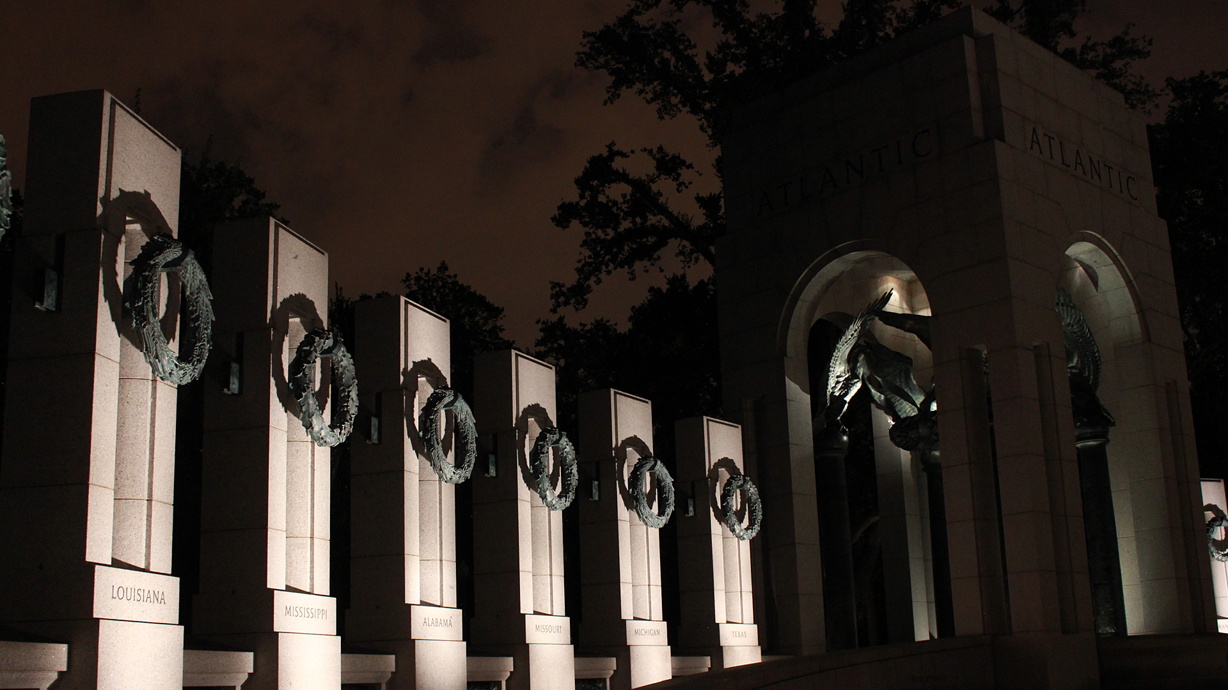

Slide 39
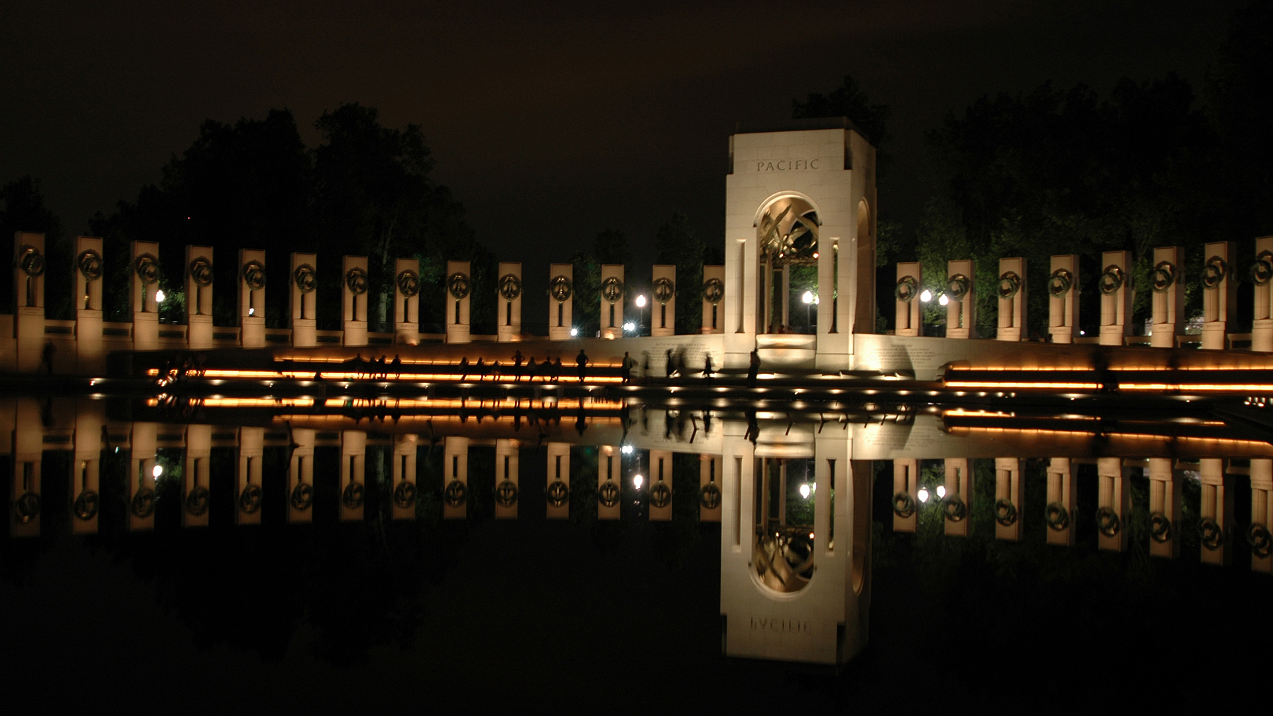

Slide 40
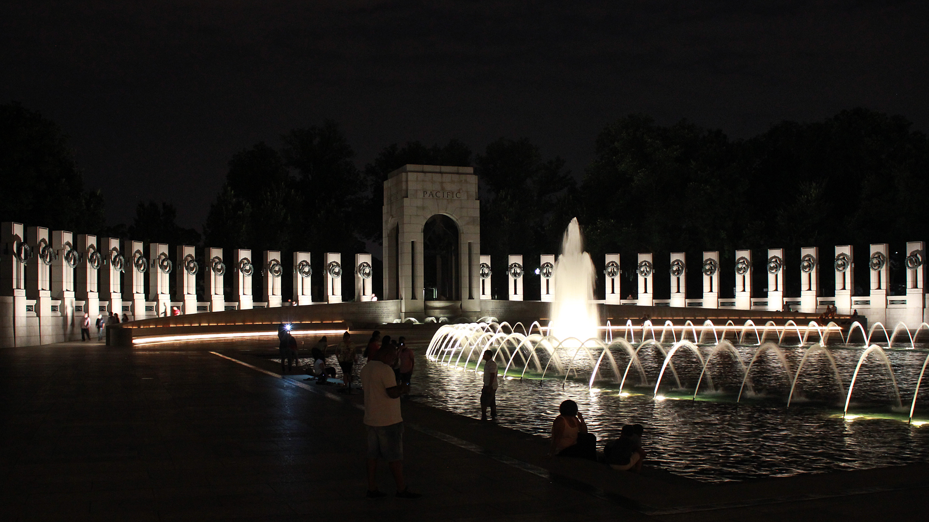
World War II Memorial

Slide 41
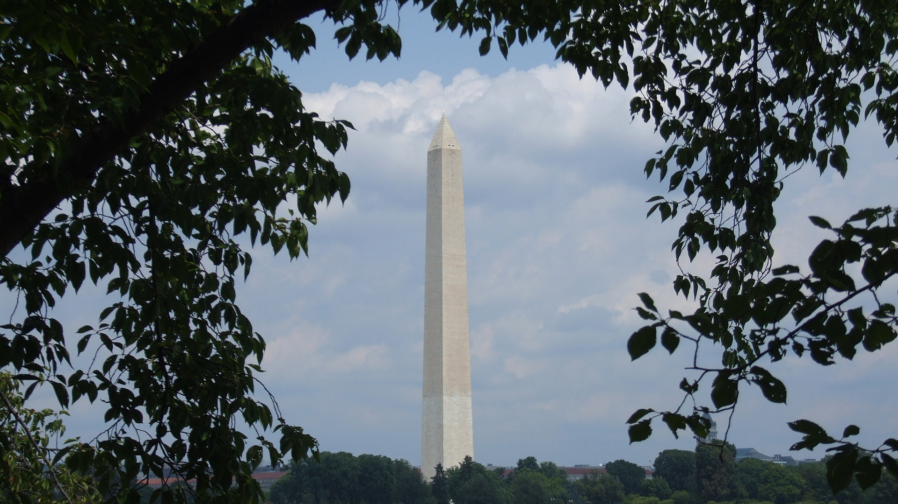

Slide 42
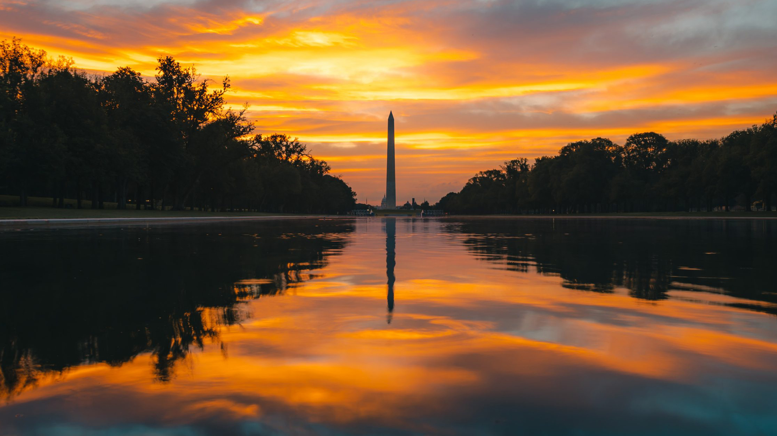
Washington Monument

Slide 43
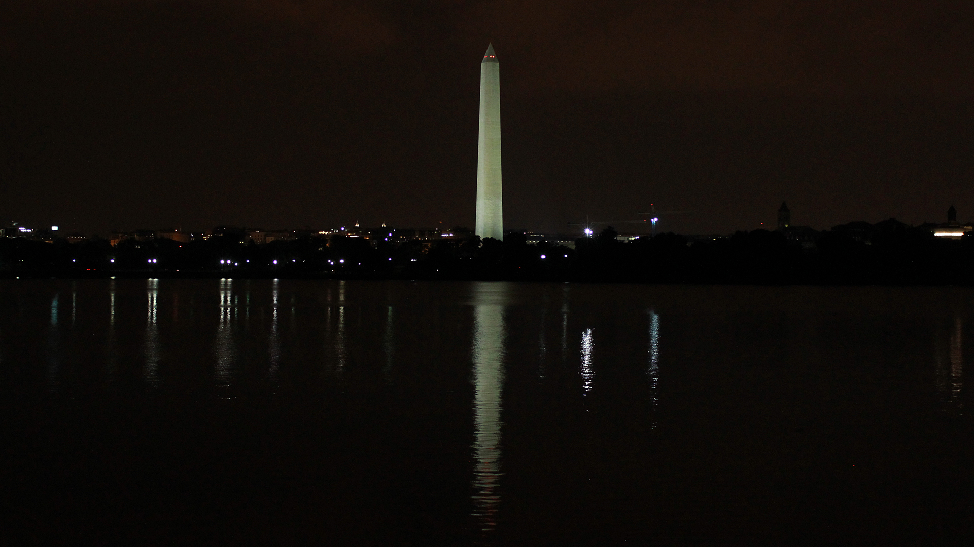

Slide 44
Smithsonian Museums on the Mall

Slide 45
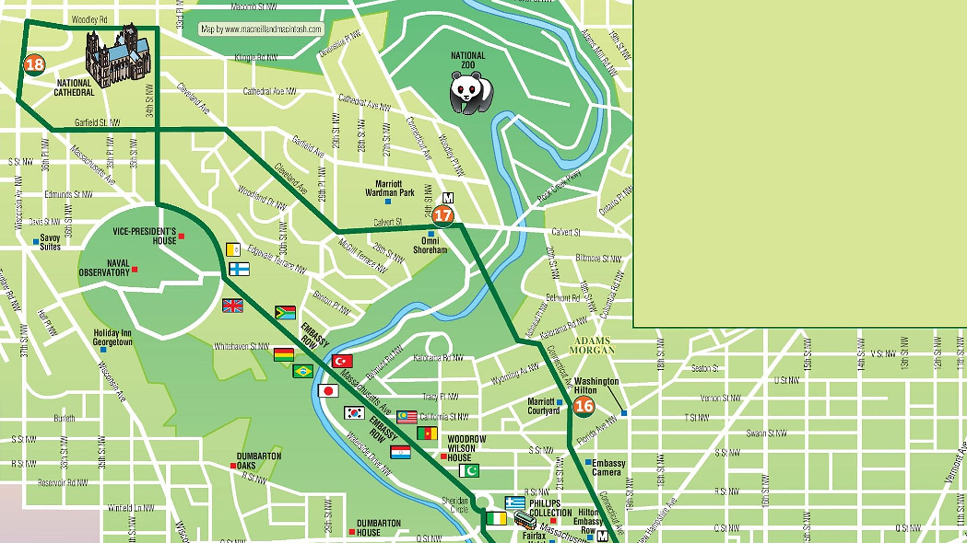
Northwest of the White House
- Embassy Row
- Vice-Presidents House
- National Cathedral
- National Zoo

Slide 46
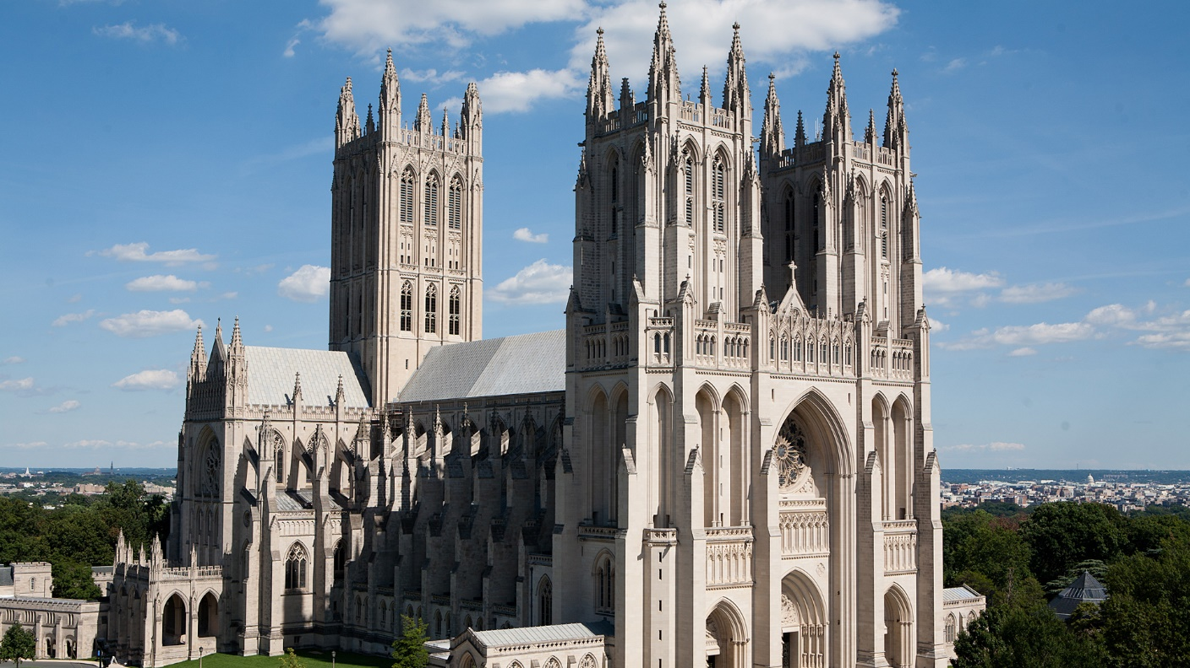
National Cathedral

Slide 47
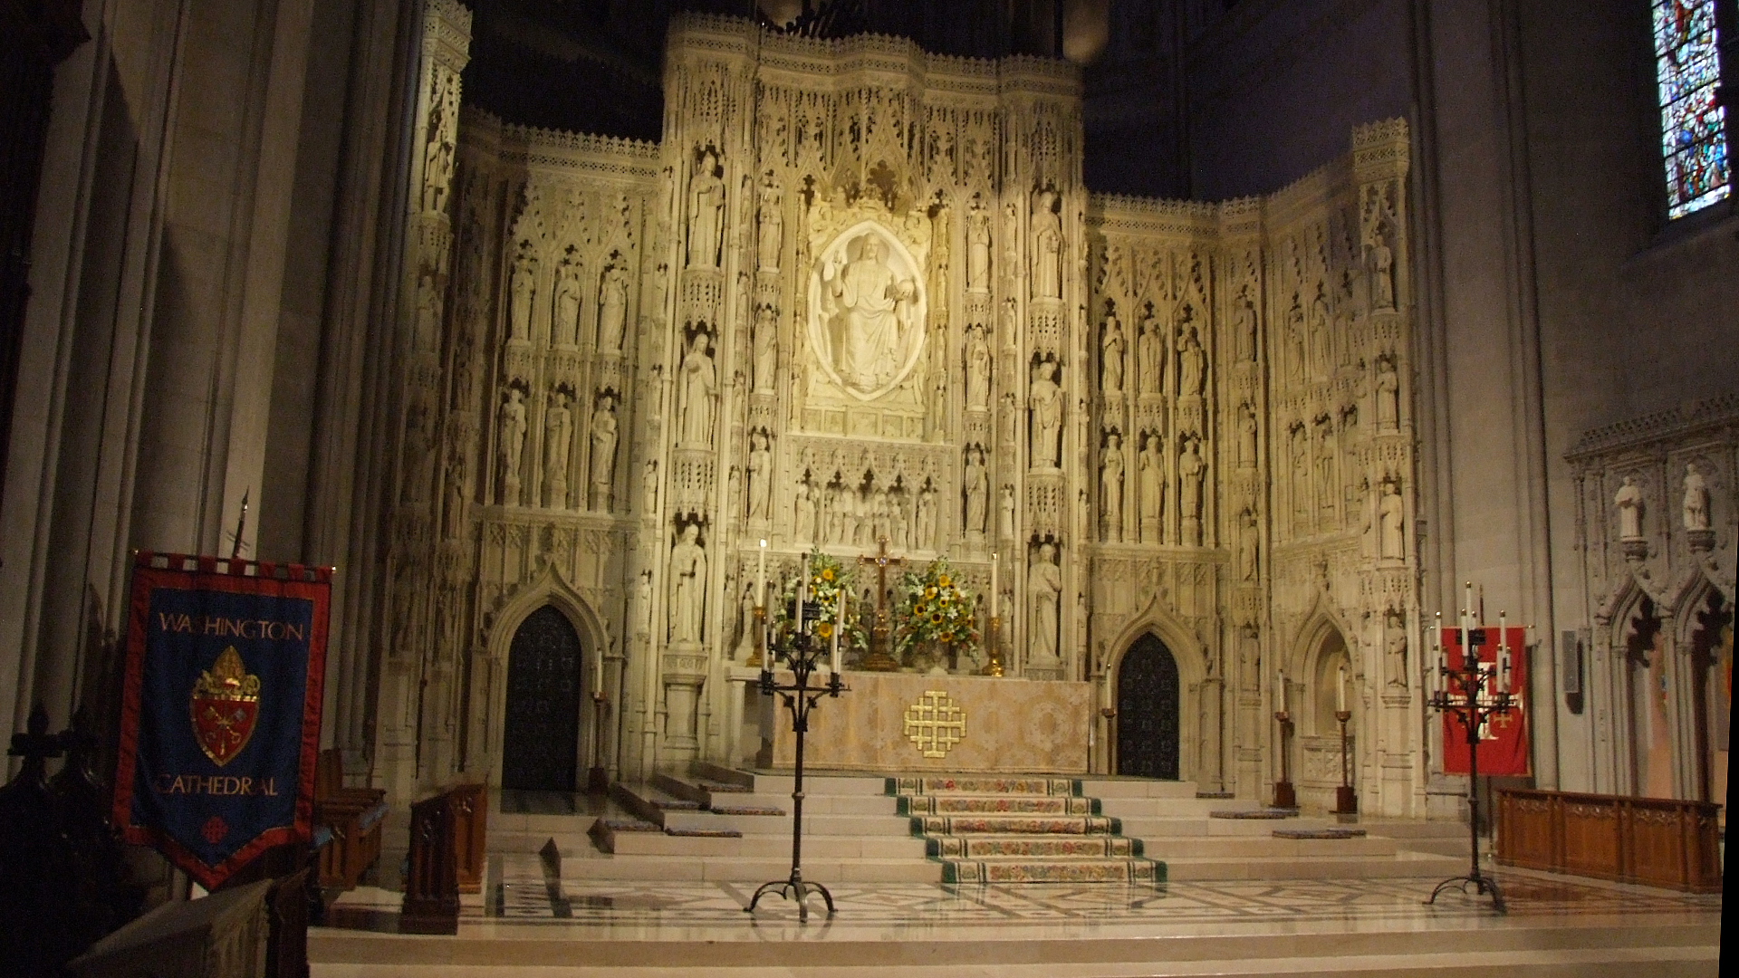

Slide 48
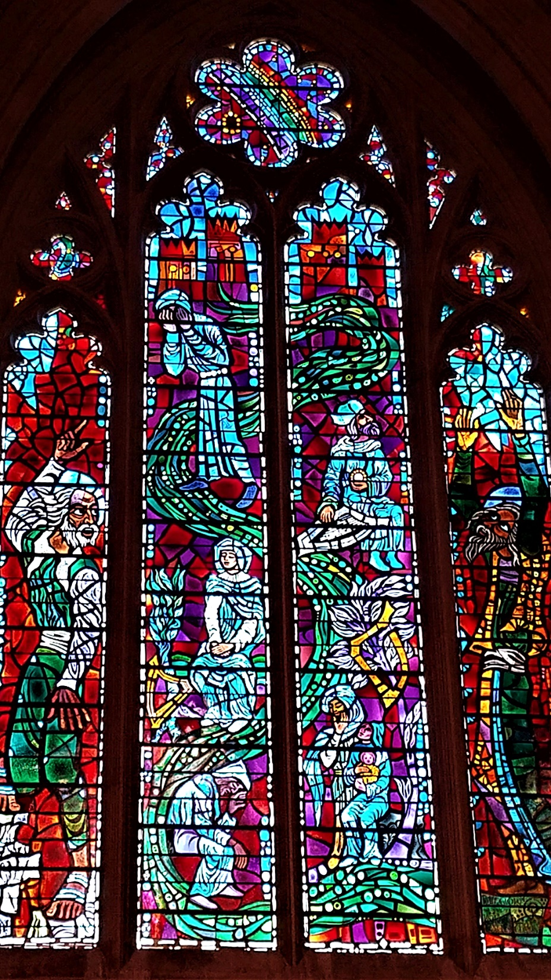
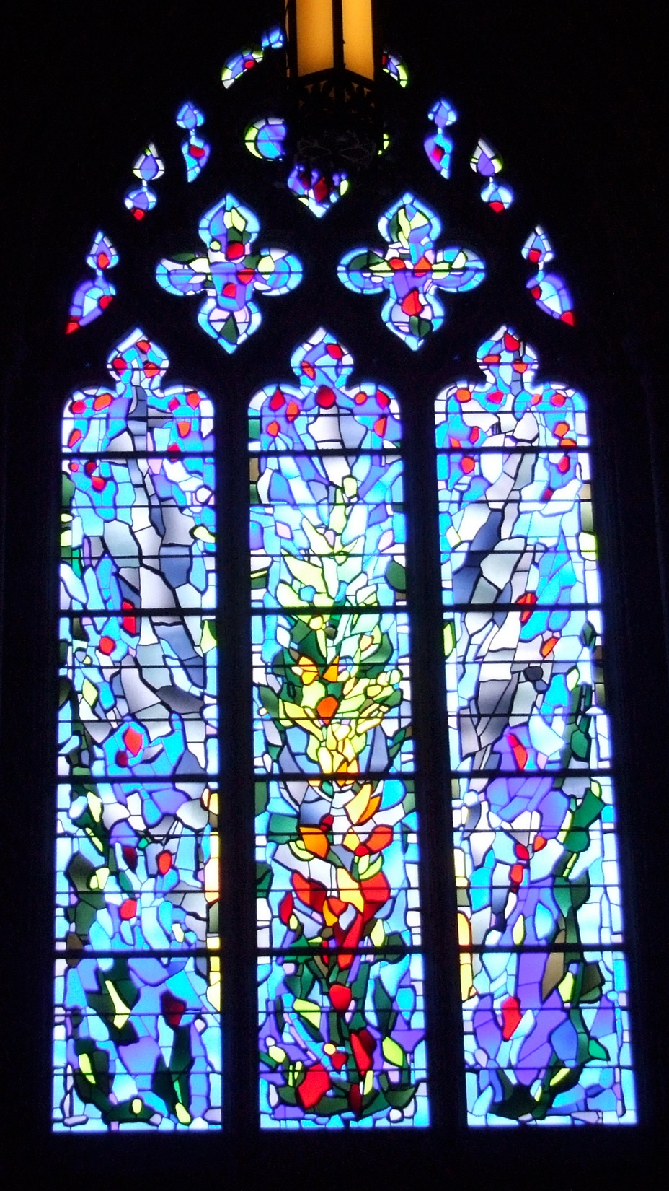
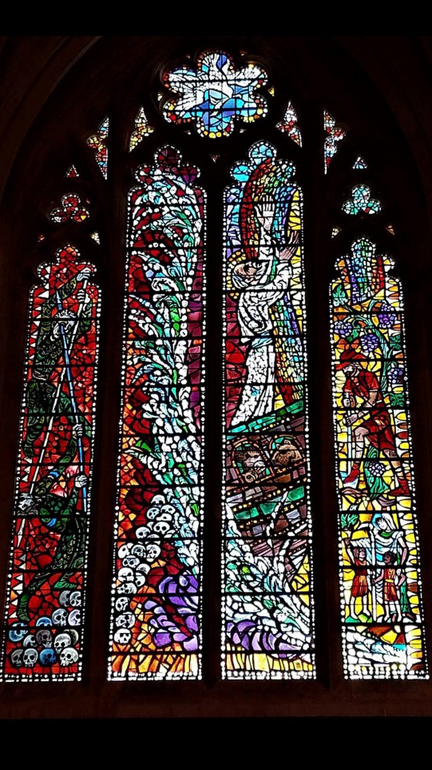

Slide 49
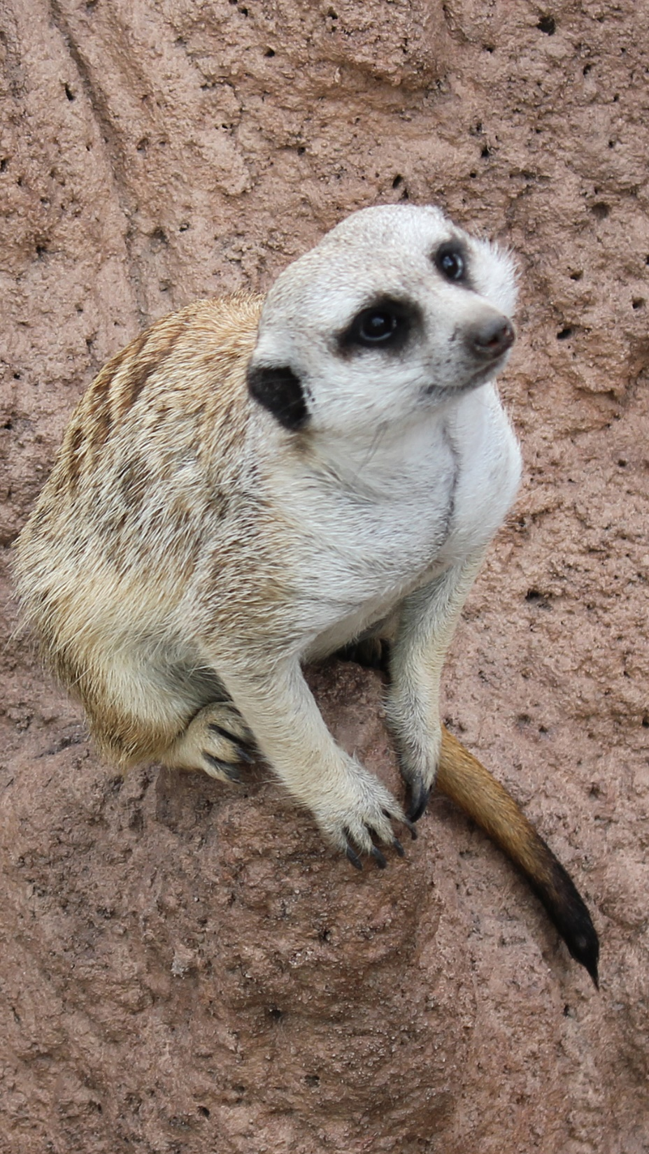
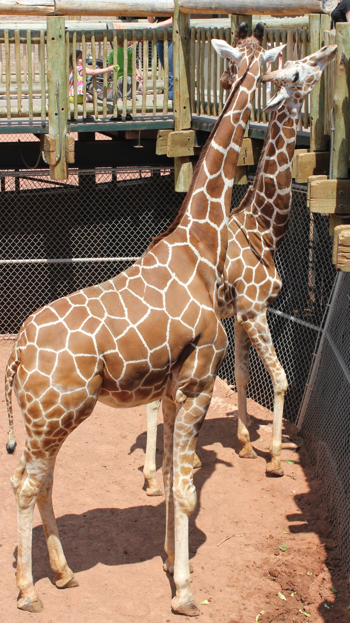
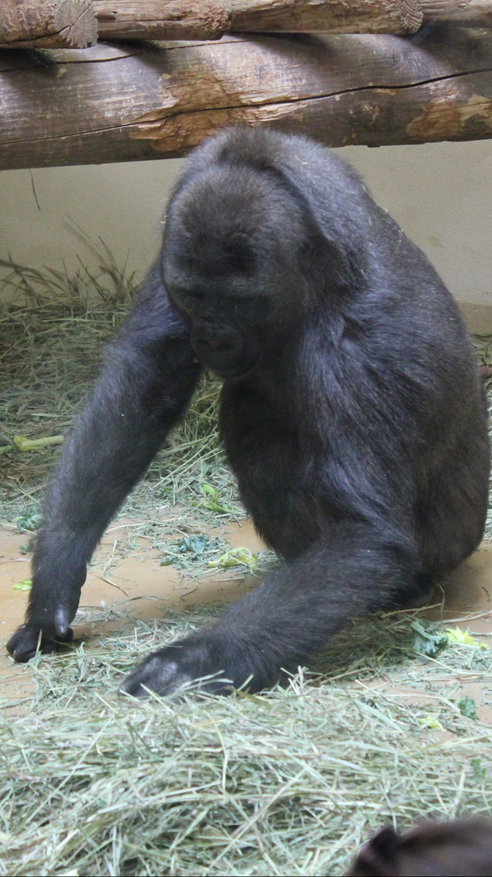

Slide 52
Smithsonian Museums on the Mall

Slide 53
Ronald Reagan Building and International Trade Center

Slide 55
Woodrow Wilson International
Center for Scholars

Slide 59
Naval Memorial

Slide 61
Grand Army of the
Republic Memorial

Slide 62
National Archives

Slide 63
Smithsonian Museums on the Mall

Slide 66
Supreme Court of the United States

Slide 69
Library of Congress

Slide 72
Smithsonian Museums on the Mall

Slide 75
Smithsonian Museums on the Mall

Slide 76
United States Forest Service

Slide 77
Smithsonian Museums on the Mall

